Slide 1
Next Generation Sequencing and Bioinformatics Analysis Pipelines
Adam Ameur
National Genomics Infrastructure
SciLifeLab Uppsala
adam.ameur@igp.uu.se
Notes:
1

Slide 2
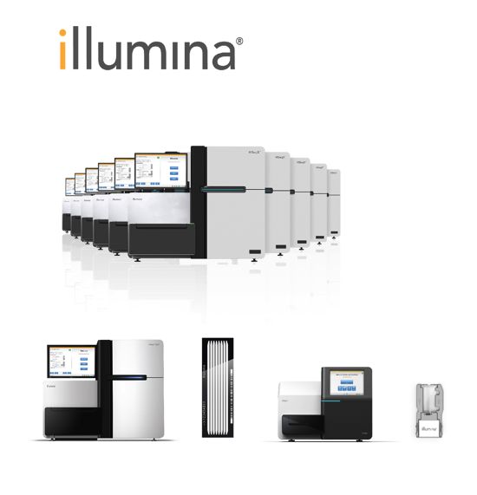
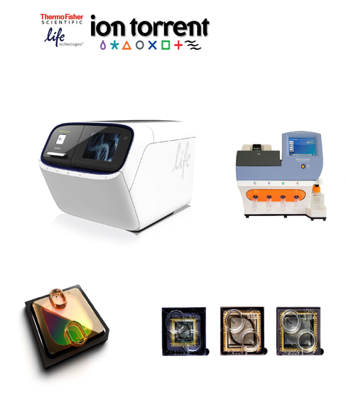
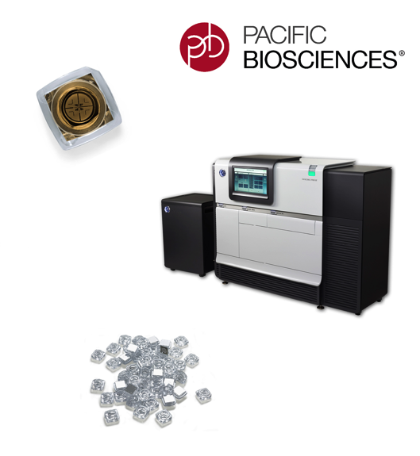

Today’s lecture
Management of NGS data at NGI/SciLifeLab
Examples of analysis pipelines:
Human whole genome sequencing
Assembly using long reads
Clinical routine sequencing
Notes:
2

Slide 3
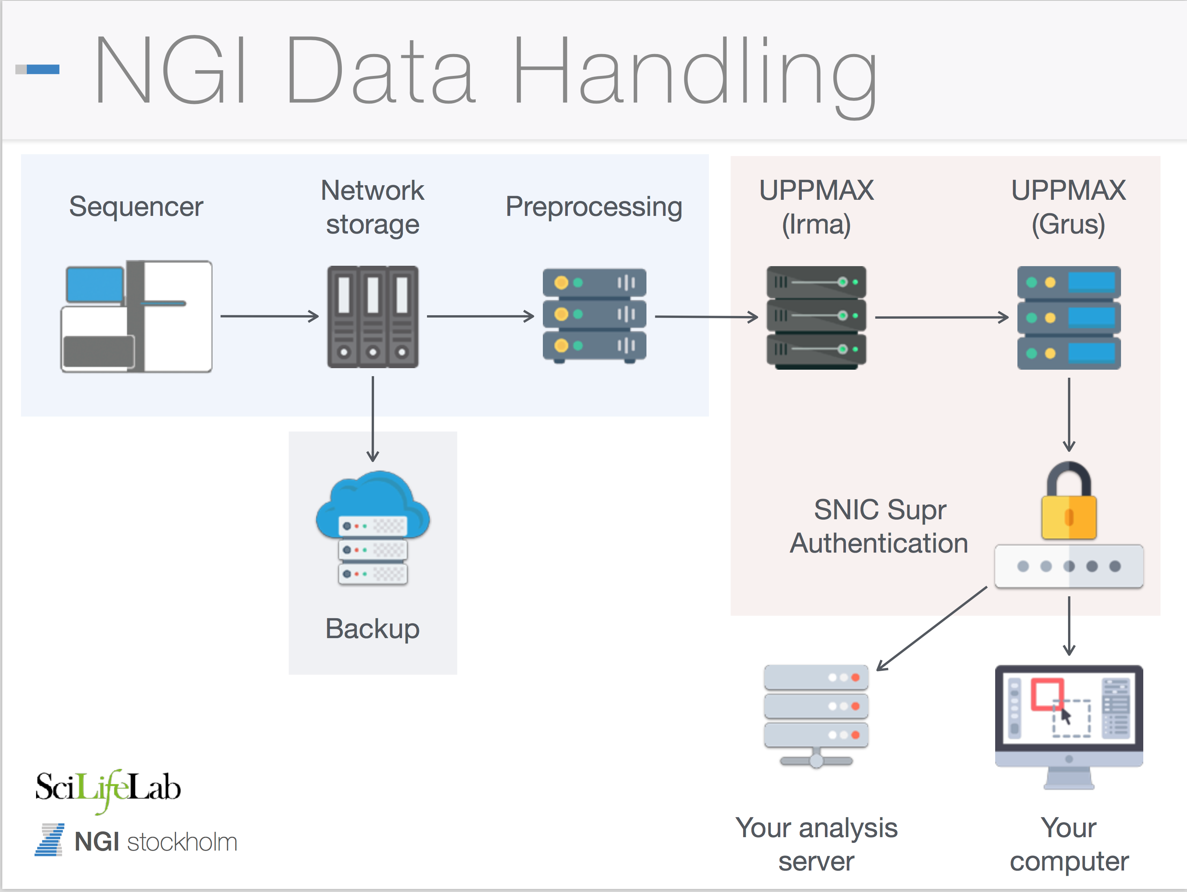
Notes:
3

Slide 4
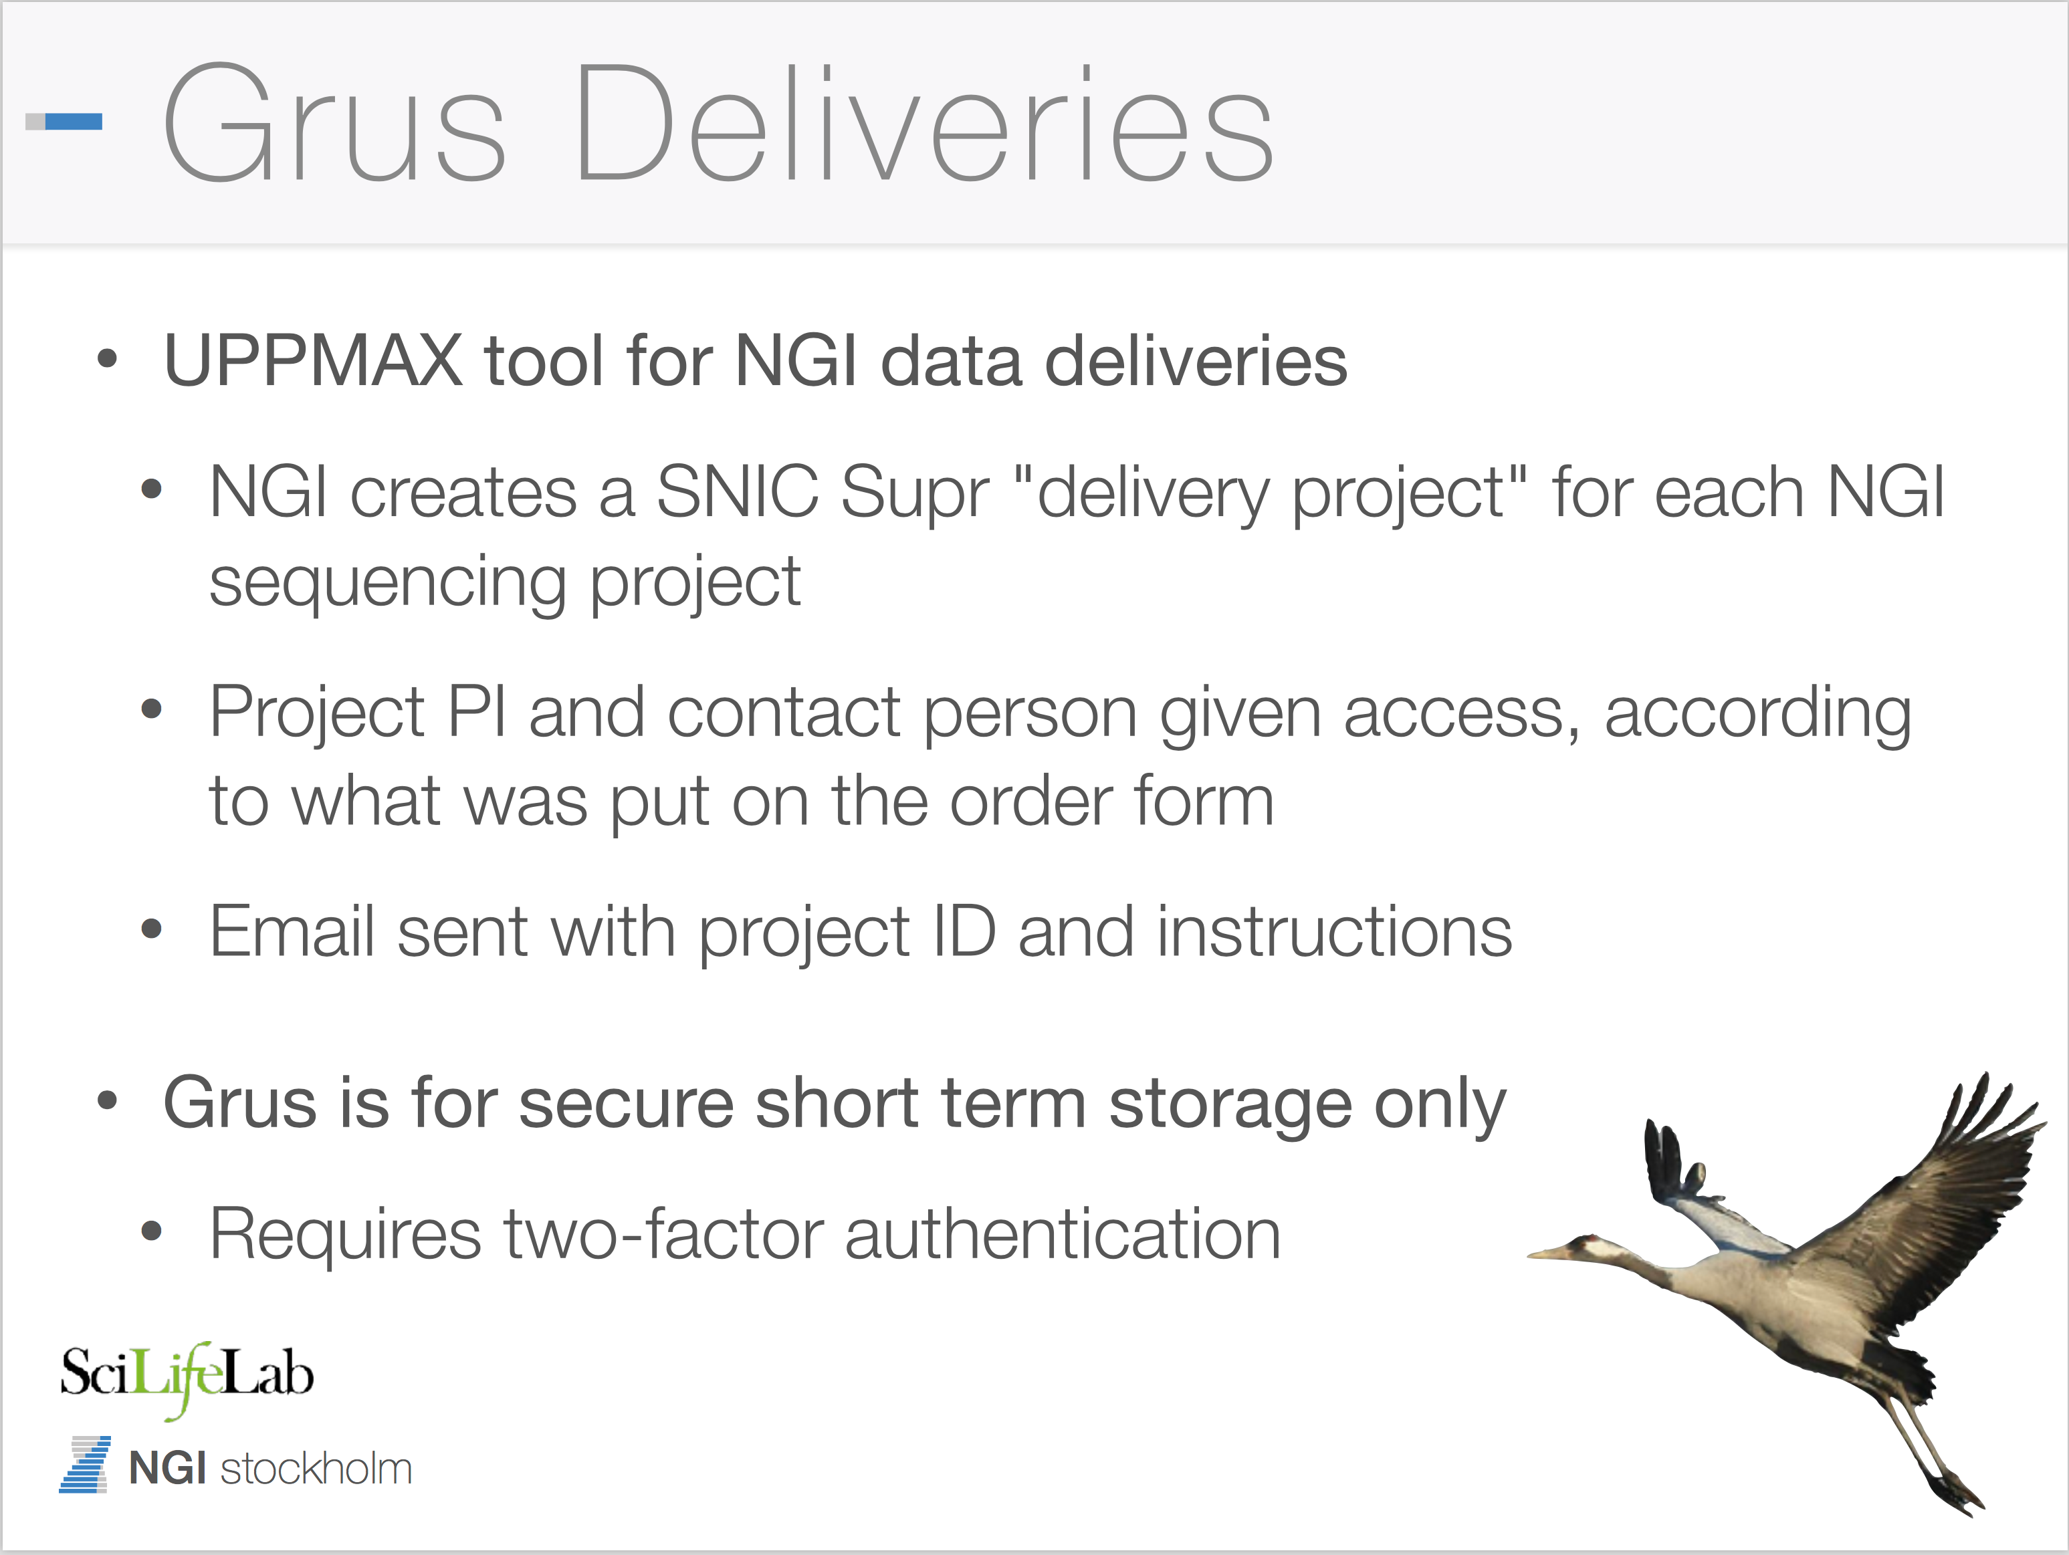
Notes:
4

Slide 5
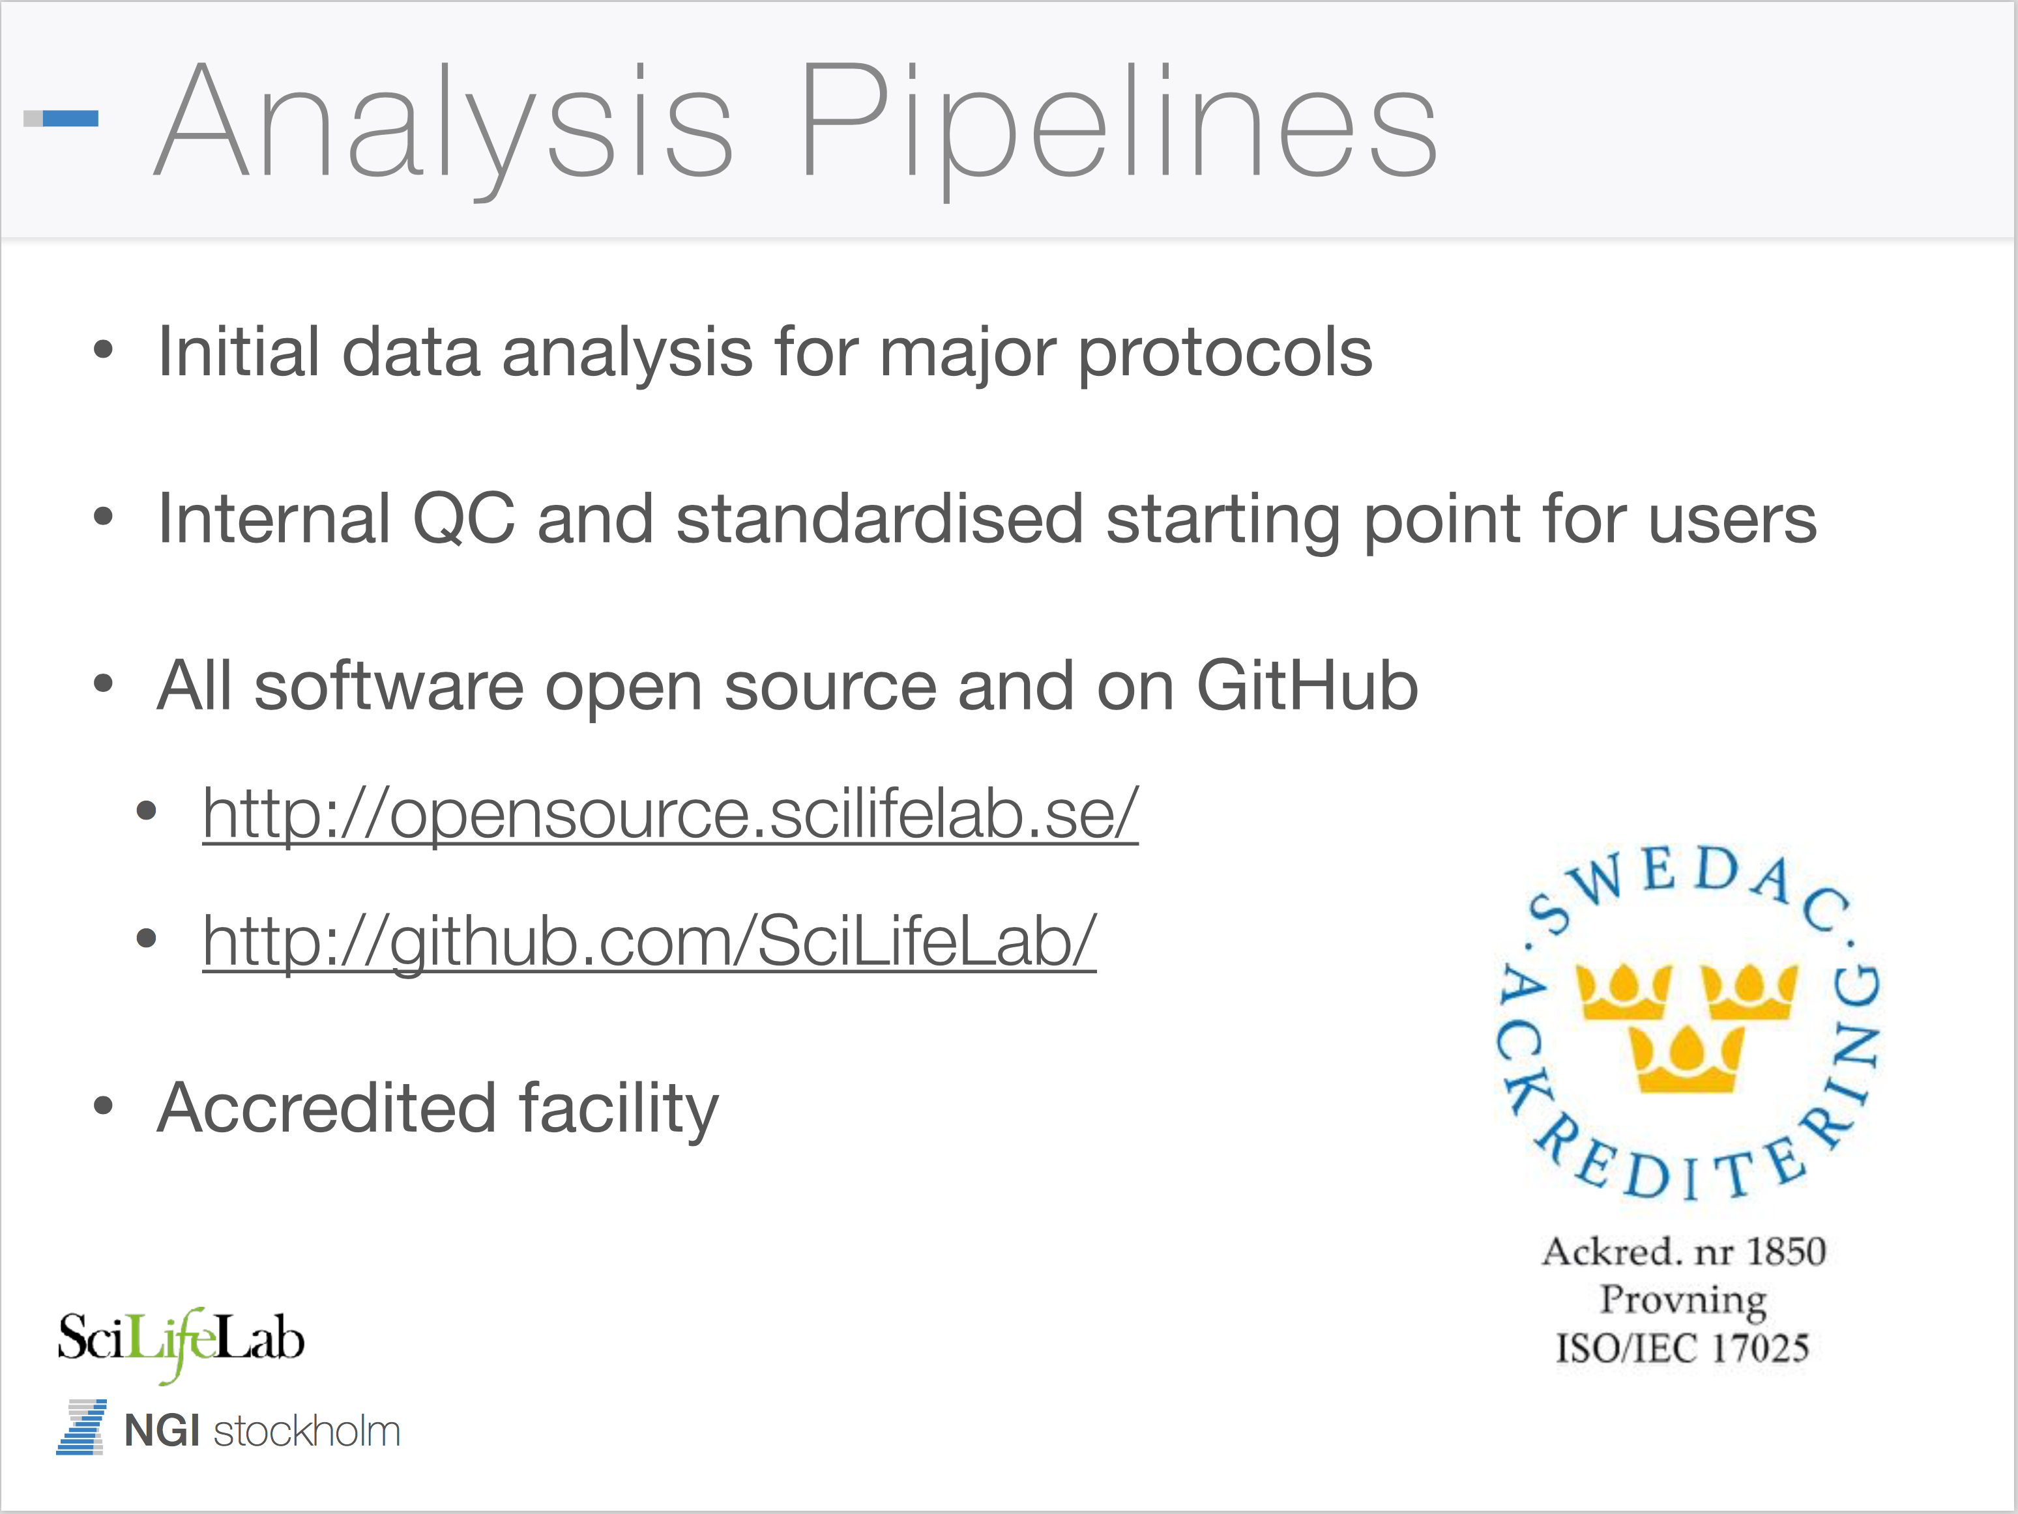
Notes:
5

Slide 6
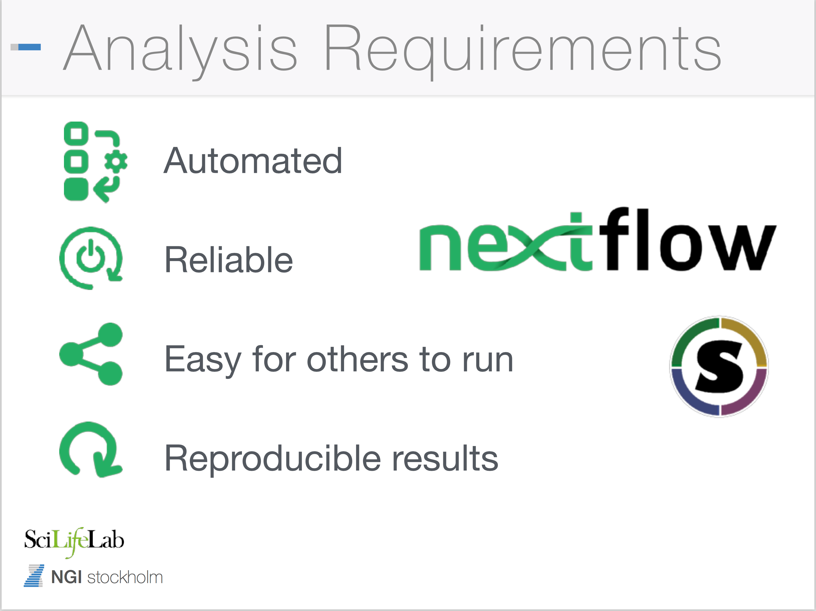
Notes:
6

Slide 7
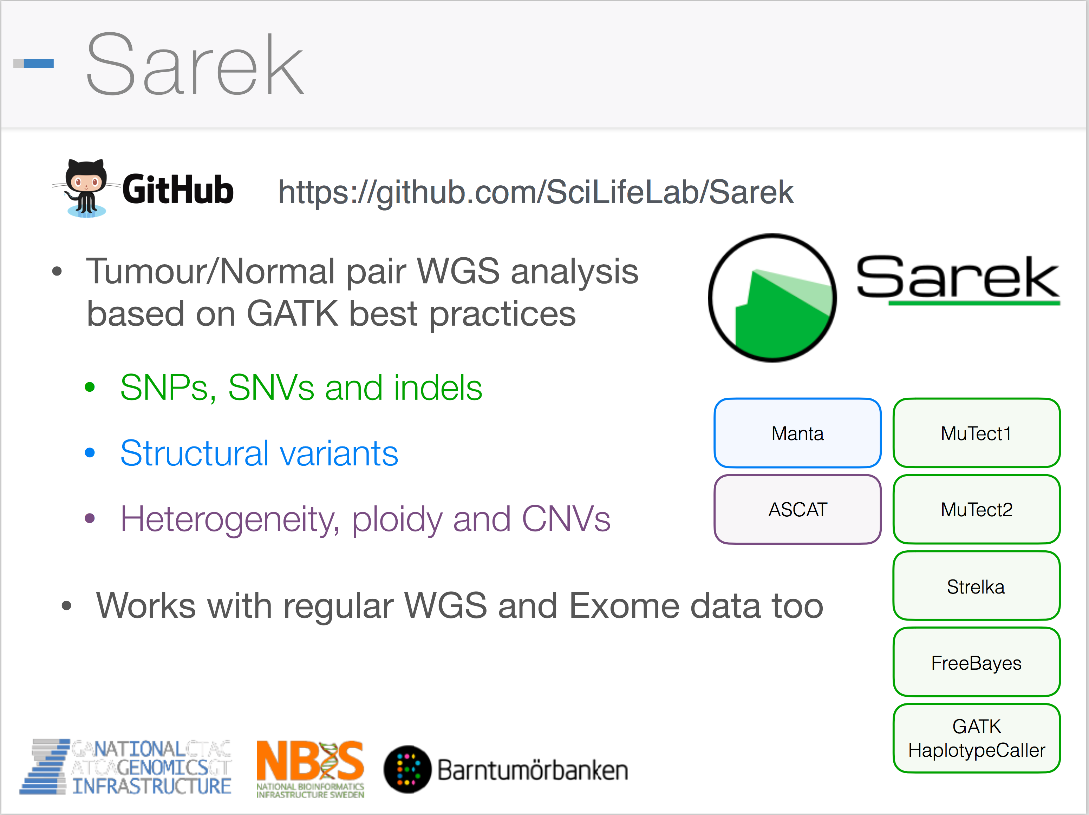
Notes:
7

Slide 8
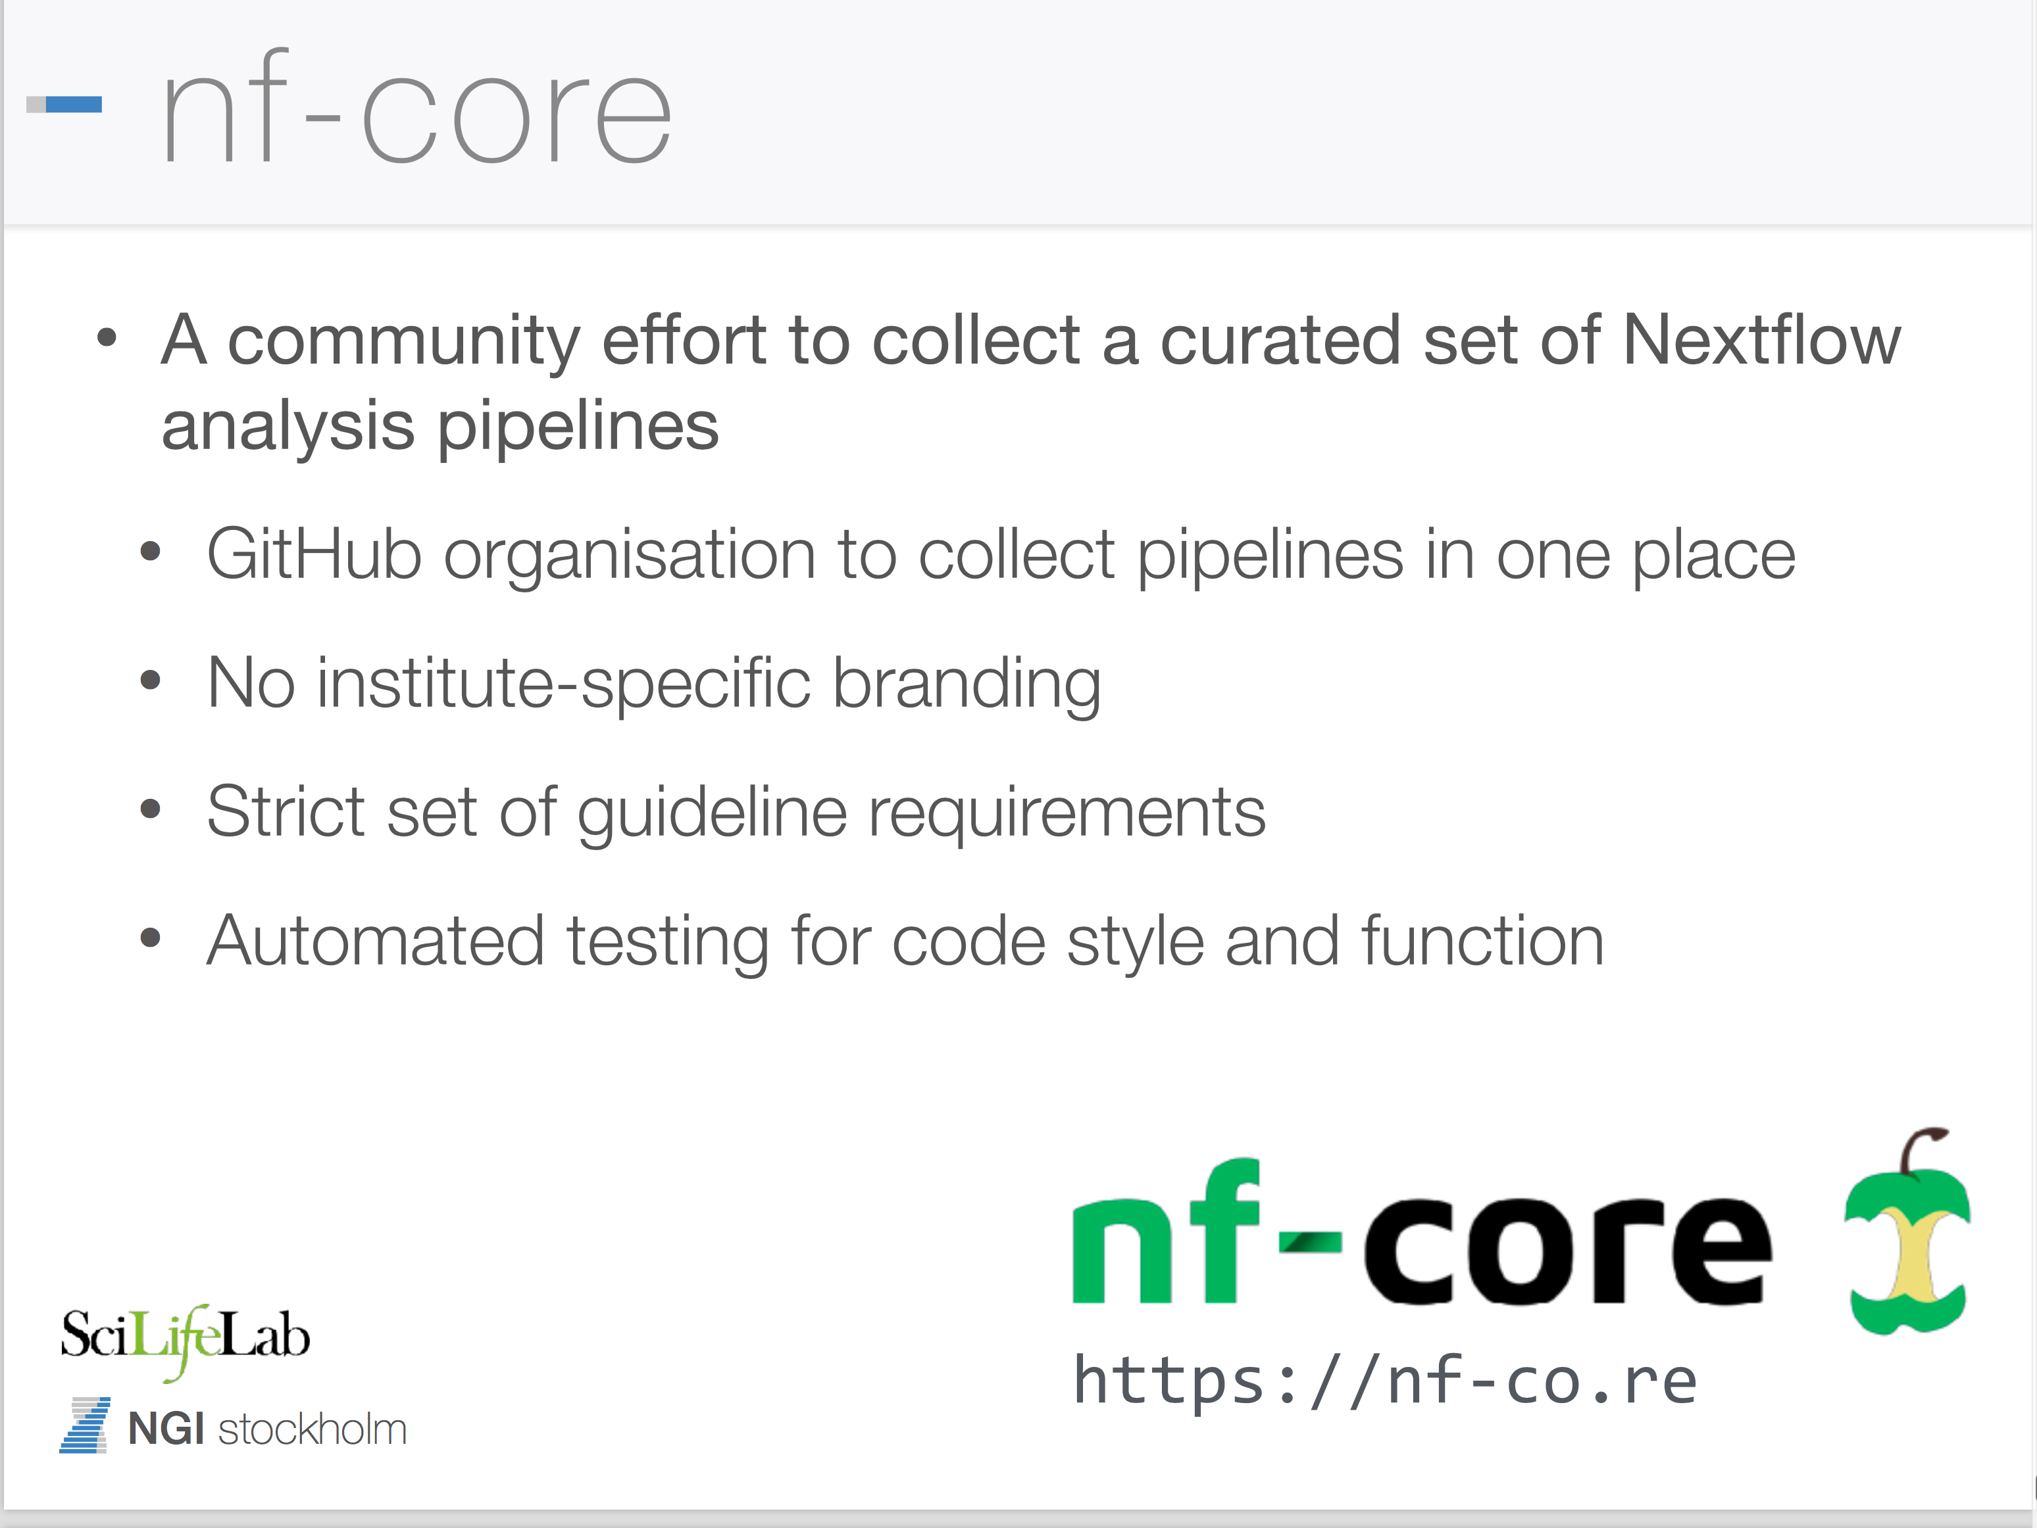
Notes:
8

Slide 9
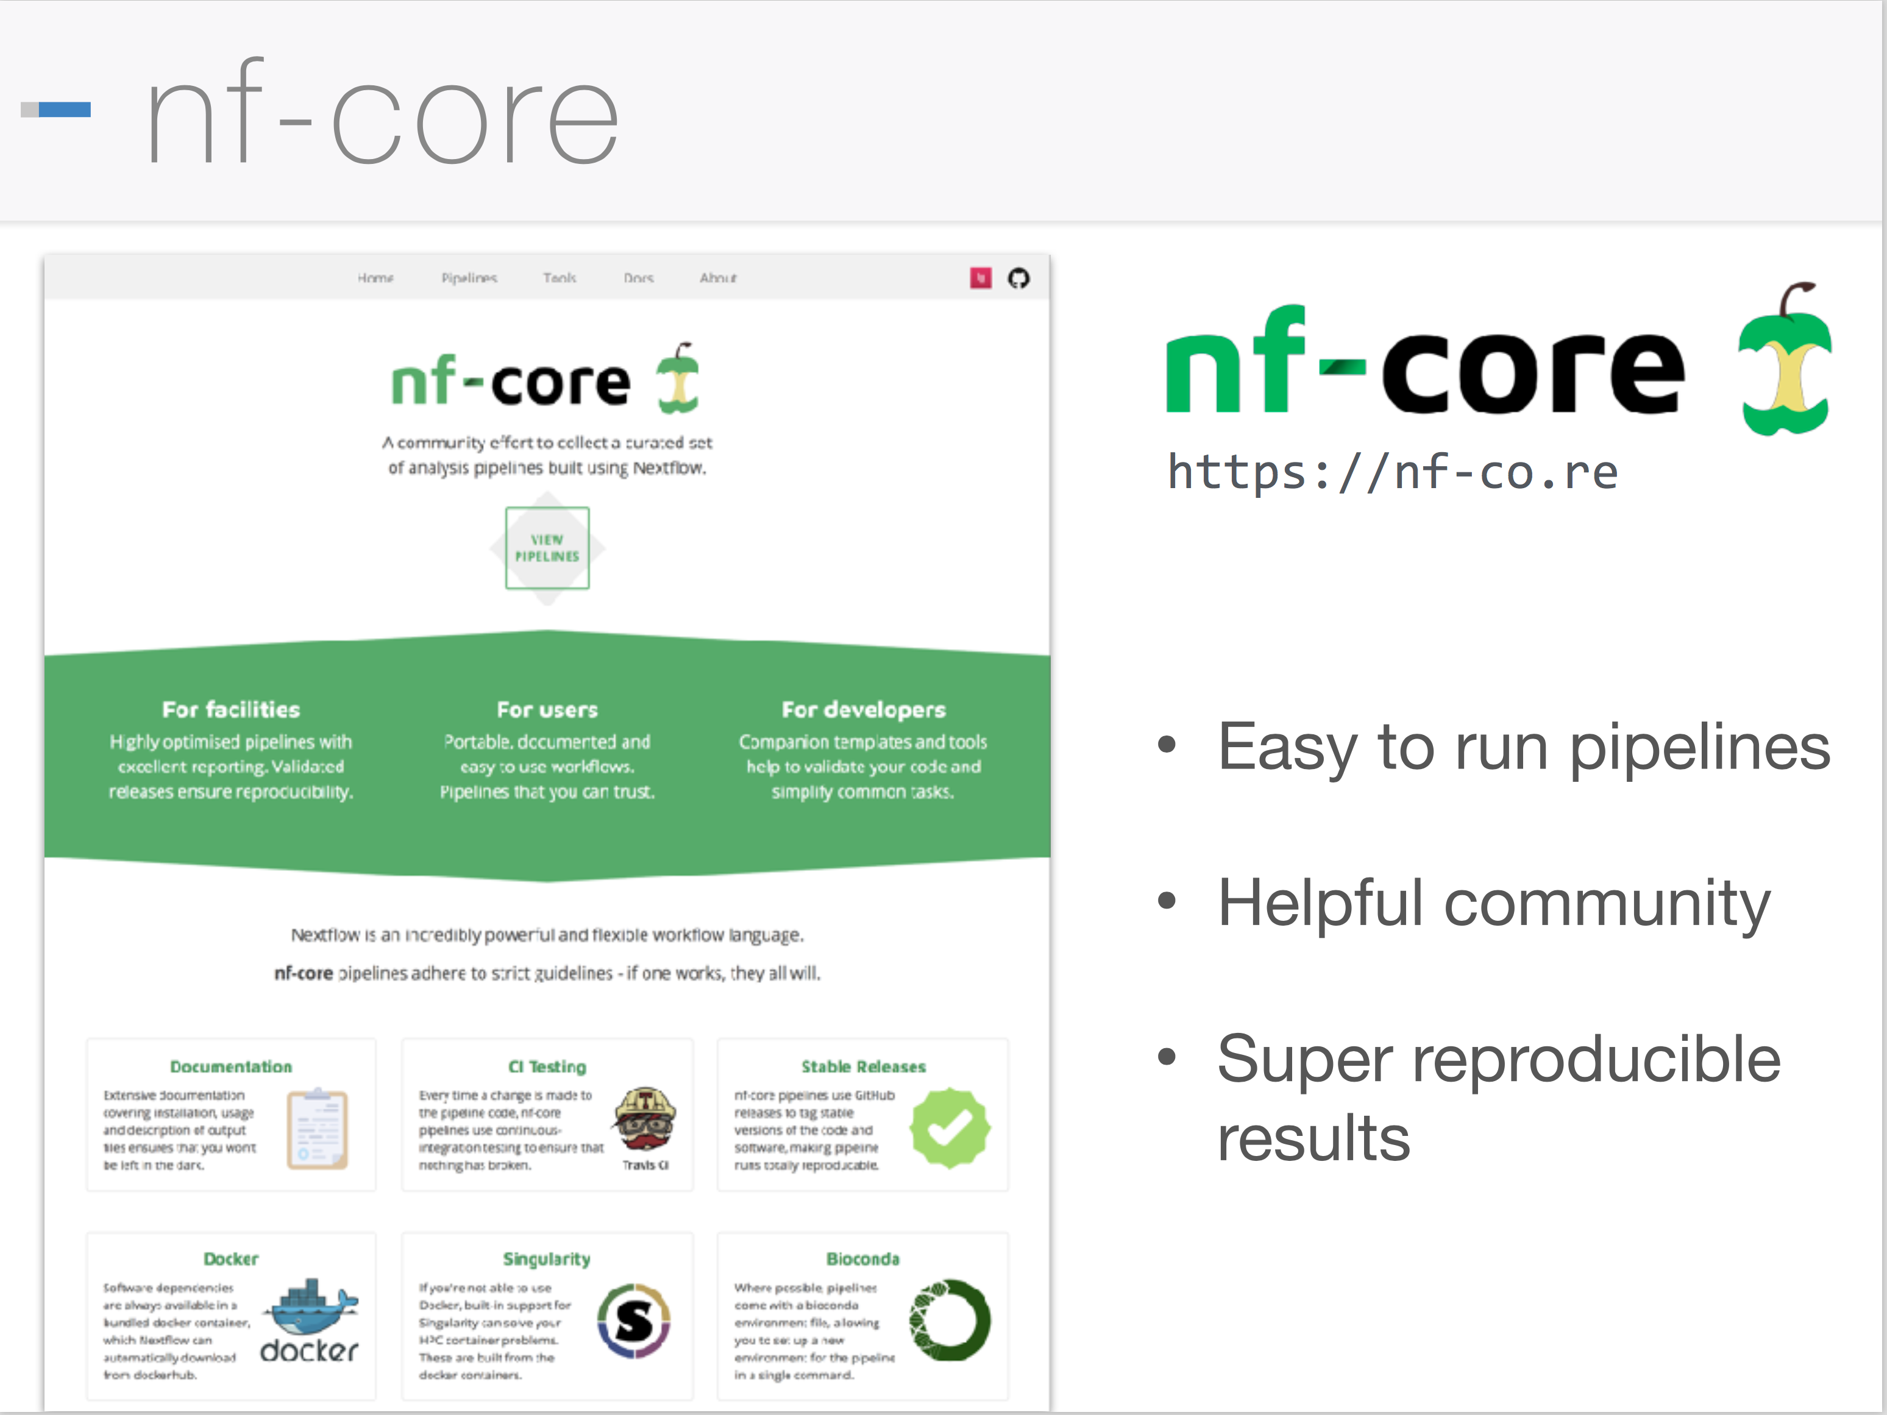
Notes:
9

Slide 10
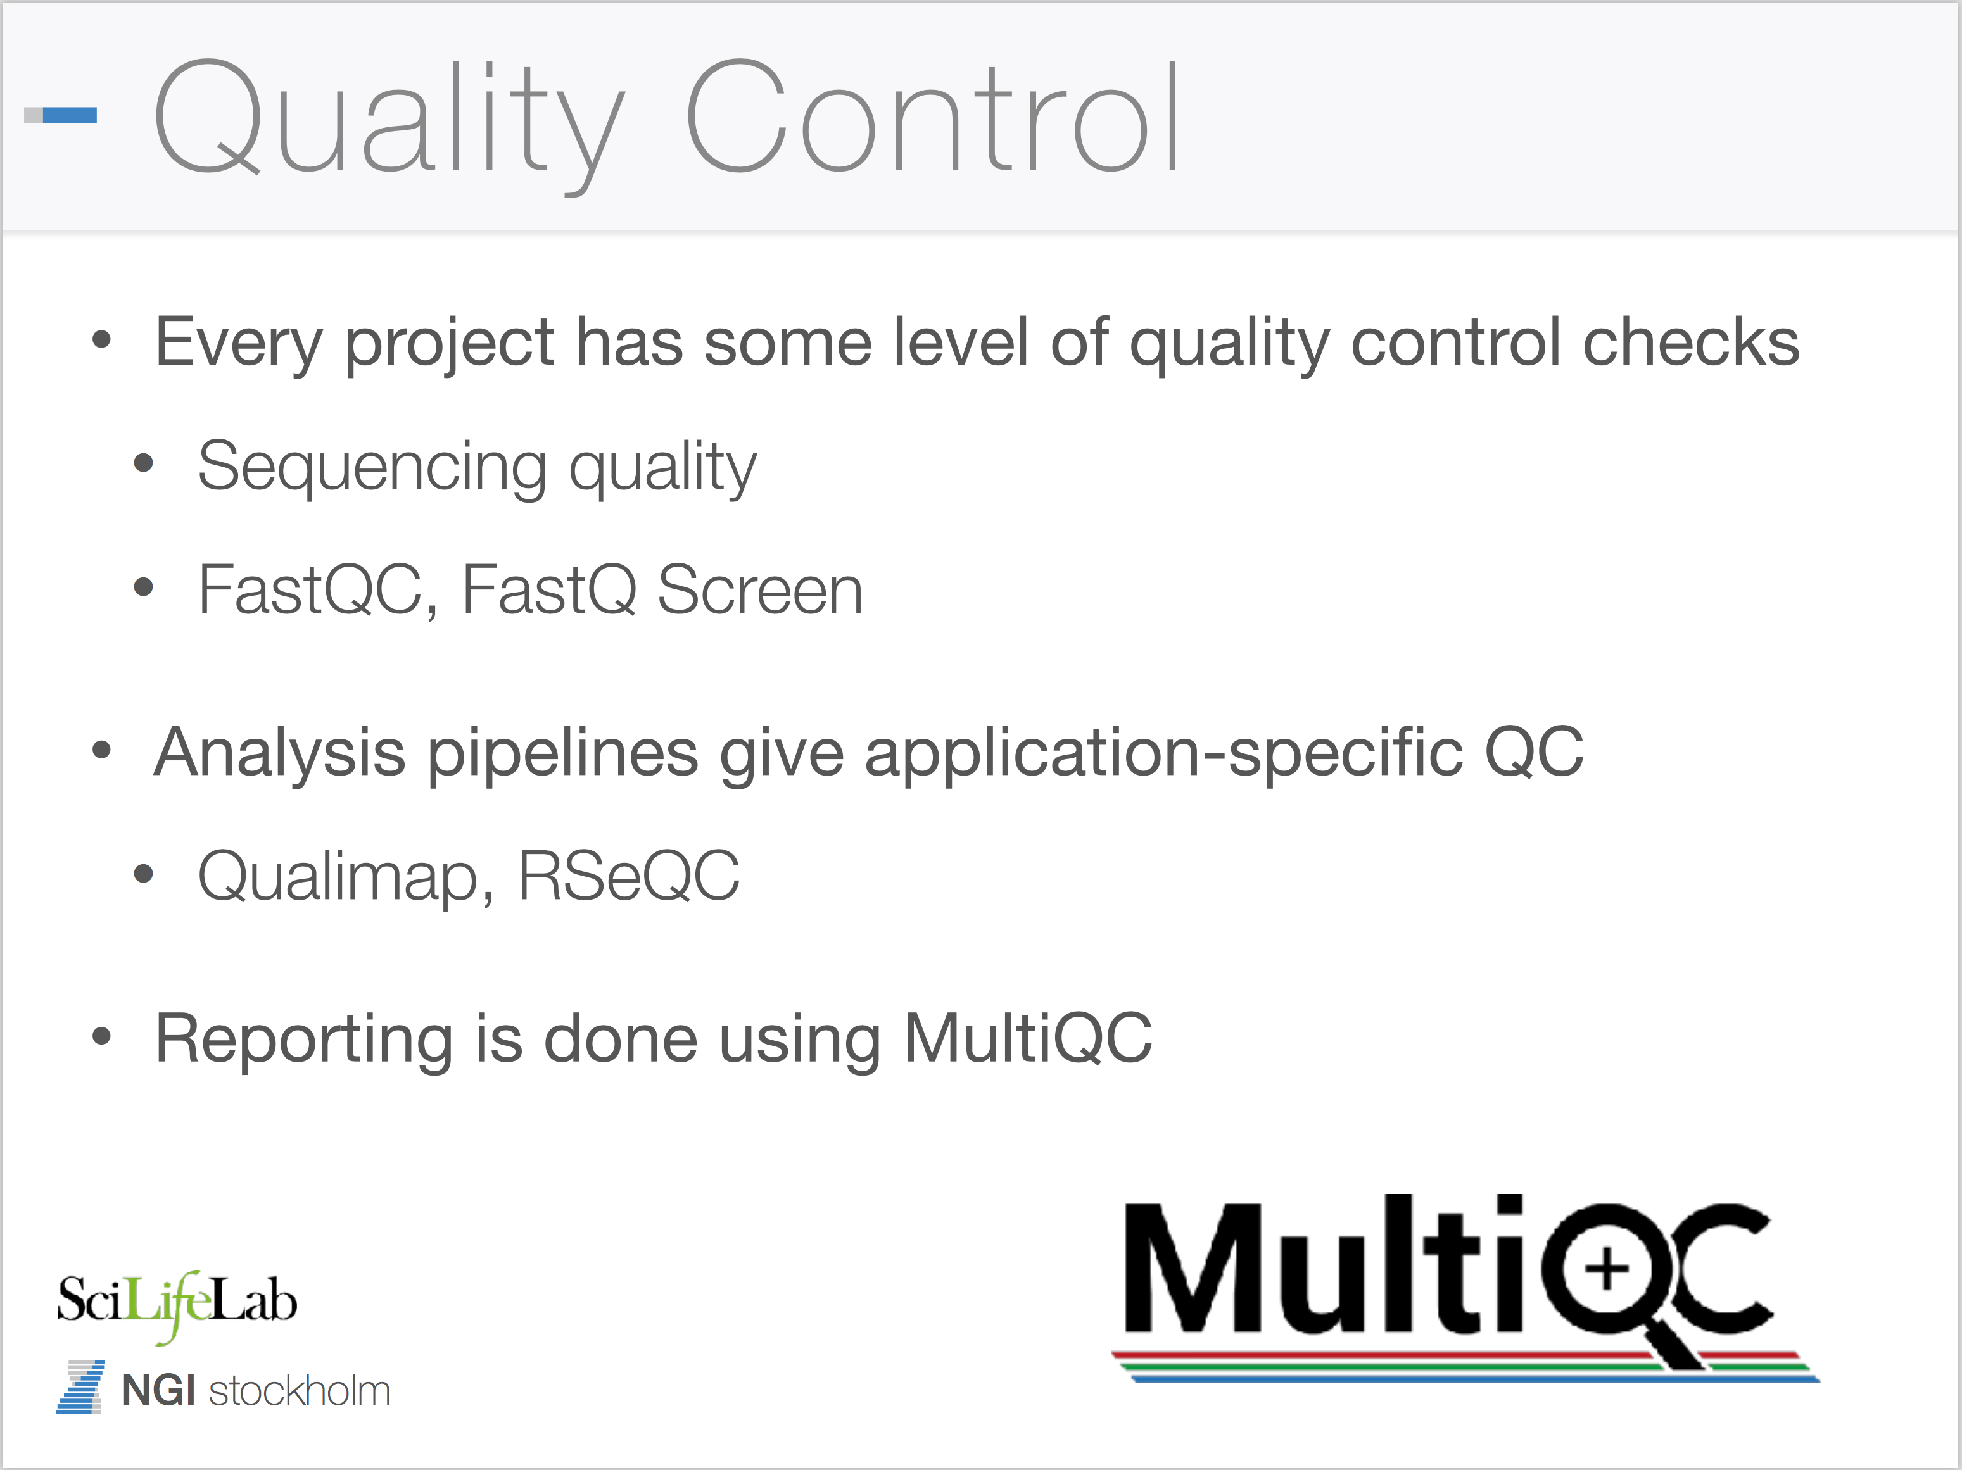
Notes:
10

Slide 11
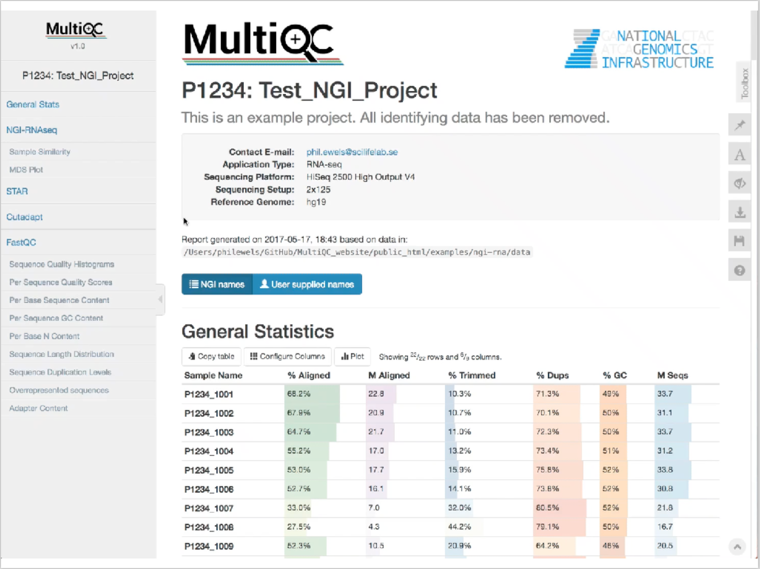
Notes:
11

Slide 12
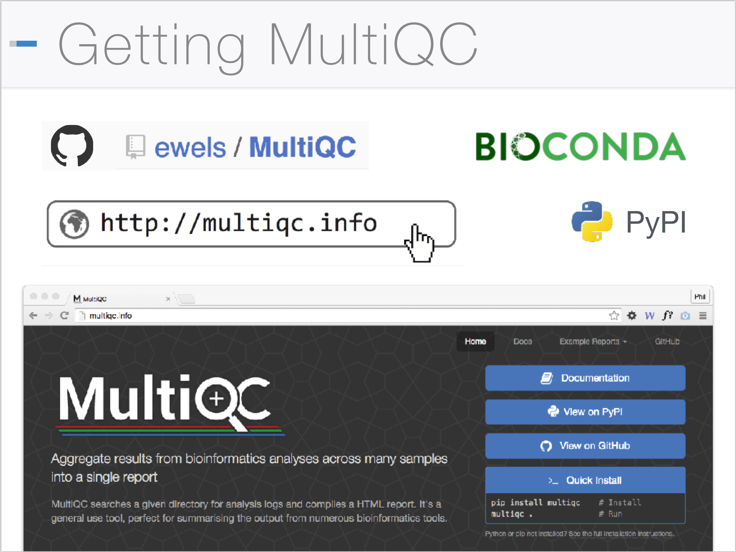
Notes:
12

Slide 13

Human Whole Genome Sequencing
Crowd image via www.shutterstock.com

Slide 14
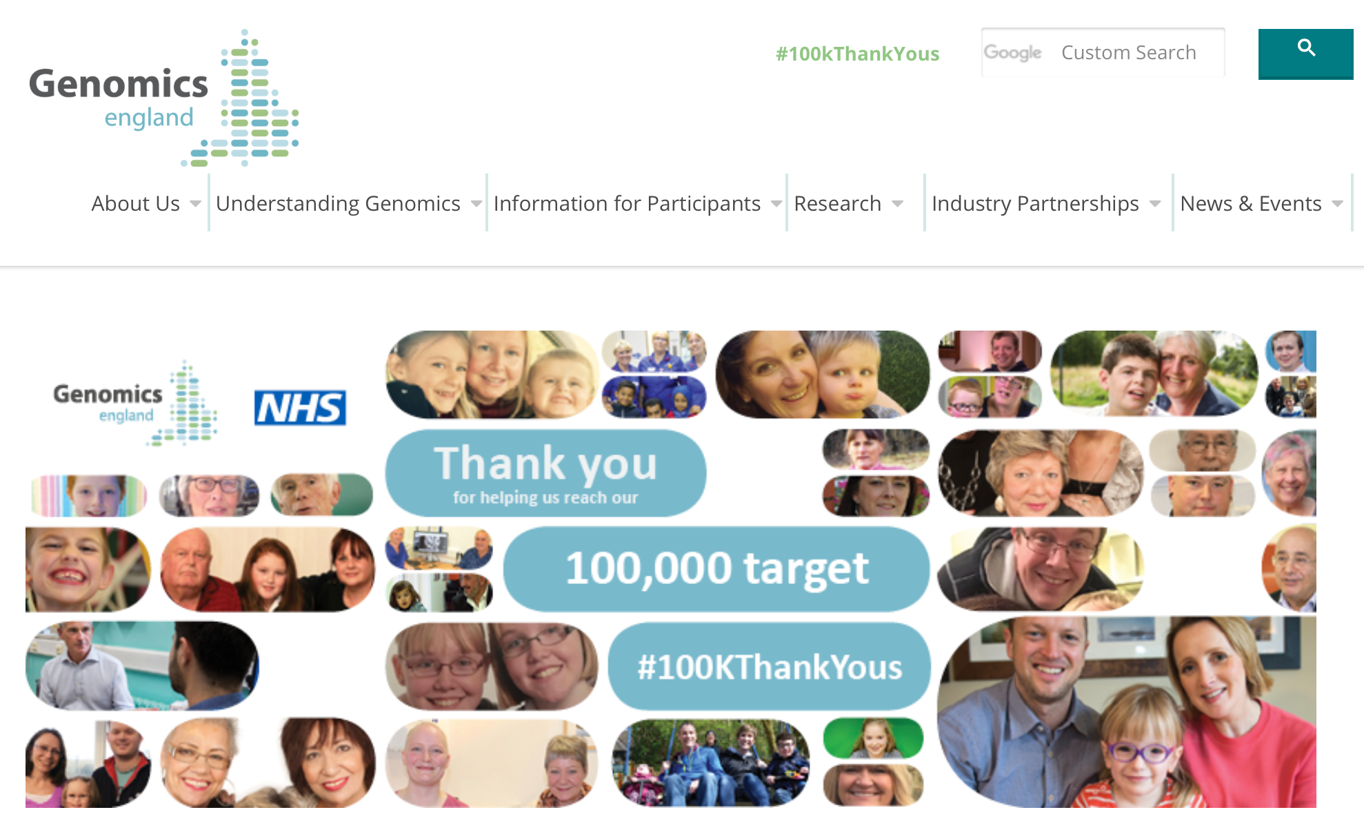
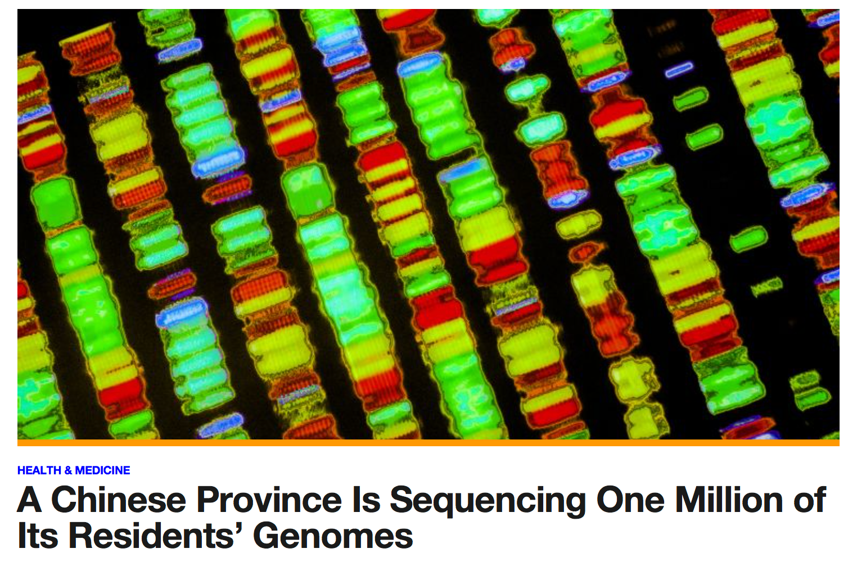
WGS projects all around the world
Notes:
14

Slide 15
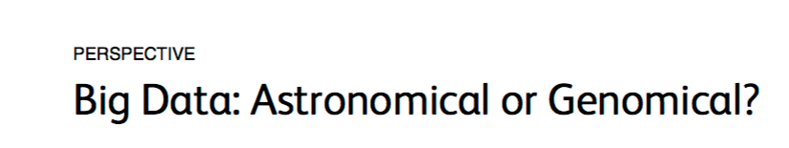
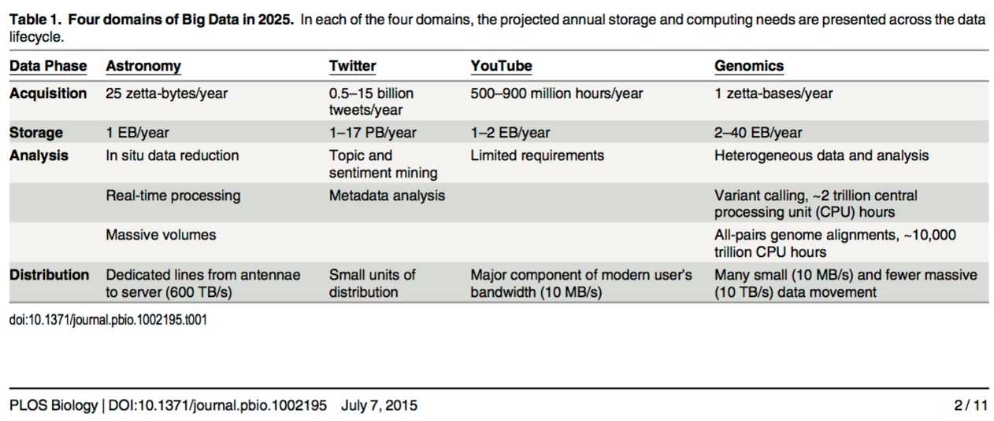

Slide 16
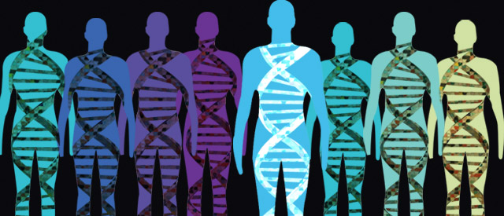
Whole Genome Sequencing in Sweden
Over 10k genomes/year can be produced in Sweden!
Research projects (disease cohorts)
Reference database (cross-section of population)
Clinical sequencing
Notes:
16

Slide 17

The Swedish 1000 Genomes Project
A resource for researchers and clinical labs:
From SweGen release party on Oct 19th 2016!

Slide 18
Why 1000 Swedish whole genomes?
An important resource both for researchers and clinicians
Examples:
Look up genetic variant frequencies
Use as matched controls
Study population genetics
Study human evolutionary history
High demand for the data from many different groups:
➔ Make the data available as quickly and openly as possible!
Notes:
18

Slide 19

Deciding on a cohort to use for the project
The Swedish Twin Registry:
Inclusion based on twinning
Distribution like population density
General population-prevalence of disease
10,000 individuals have been analysed with SNP arrays
Identify 1,000 individuals based on genetic structure and diversity across Sweden

Slide 20
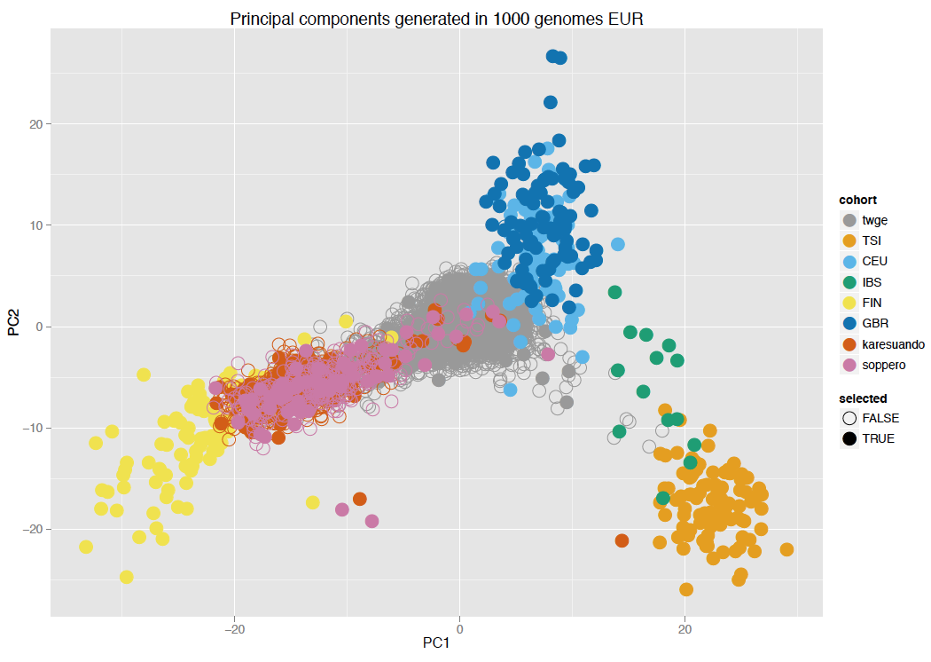
Selecting SweGen samples based on PCA
PCA of European samples from the 1000 Genomes Project and 10,000 Swedish samples
England and
Scotland
Southern-
Central
Sweden
Northern
Sweden
Italy
Finland
Spain

Slide 21
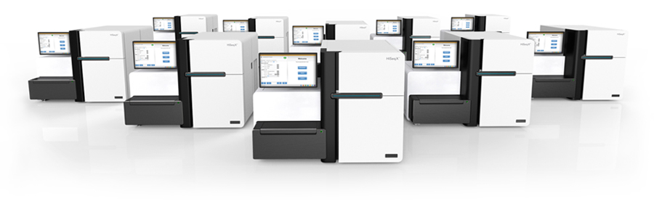
Step 1: Whole Genome Sequencing
30X Illumina WGS data generated for all 1,000 individuals
509 samples sequenced at NGI Stockholm
491 samples sequenced at NGI Uppsala
Sequencing of all 1000 samples completed in September 2016

Slide 22
Step 2: Data management and analysis
Analysis pipeline developed for mapping and variant calling
About 100,000 Gb data generated within the project
Over 2 million CPU hours used so far…
This pipeline will become standard for all WGS projects at NGI

Slide 23
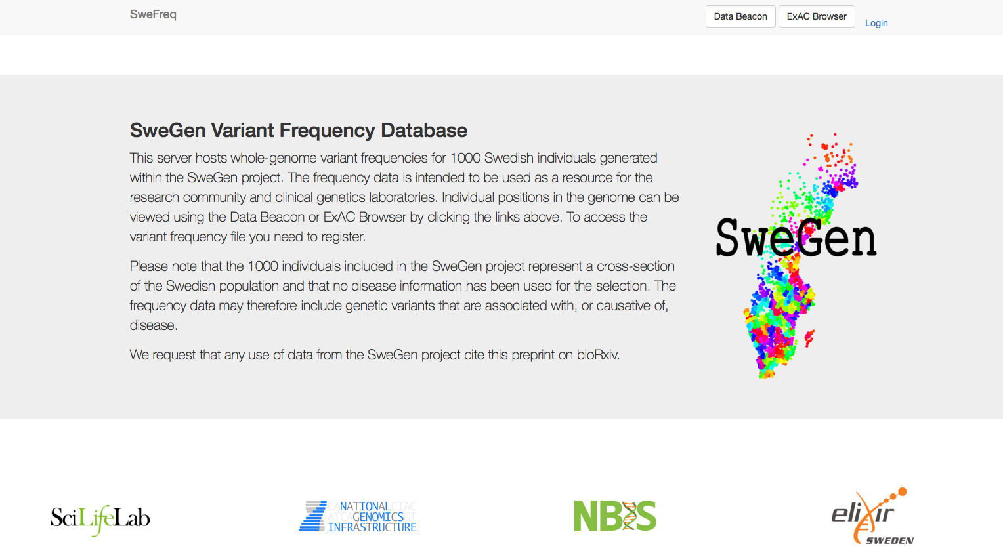
Step 3: Making frequency data available
Aggregated frequencies available from: swefreq.nbis.se!

Slide 24
Tracking the usage of SweGen data
~ 600 monthly visits to web site at present

Slide 25
SweGen – results at a glance
33 million small genetic variants detected in the 1000 samples
29.2 million SNPs, 3.8 million indels
9.9 million of these were novel (i.e. not in dbSNP147)
26,635 of the novel variants are changing protein sequence
An average of 7,199 novel variants detected per individual
➔ The SweGen dataset contributes novel genetic variation

Slide 26
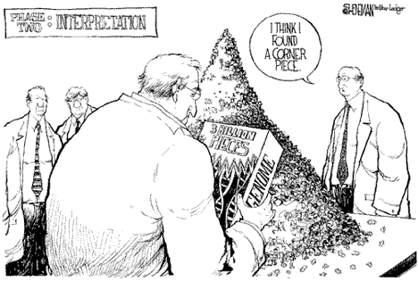
Genome assembly using long reads

Slide 27
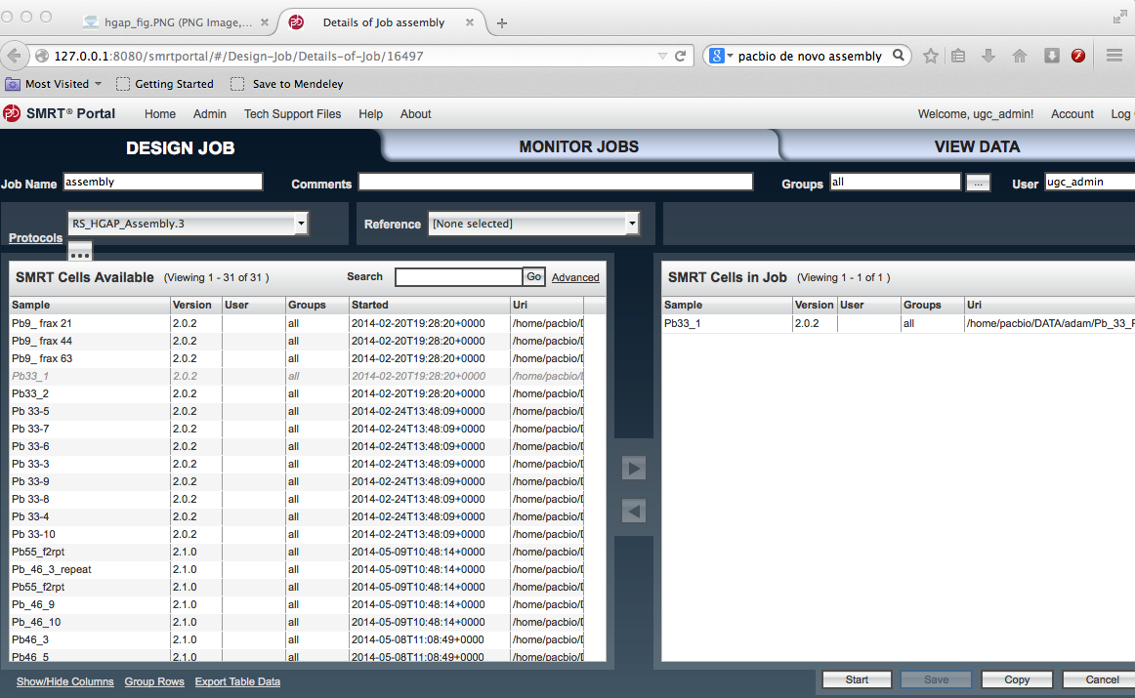
PacBio assembly analysis
Simple -- just click a button! (for small genomes)

Slide 28
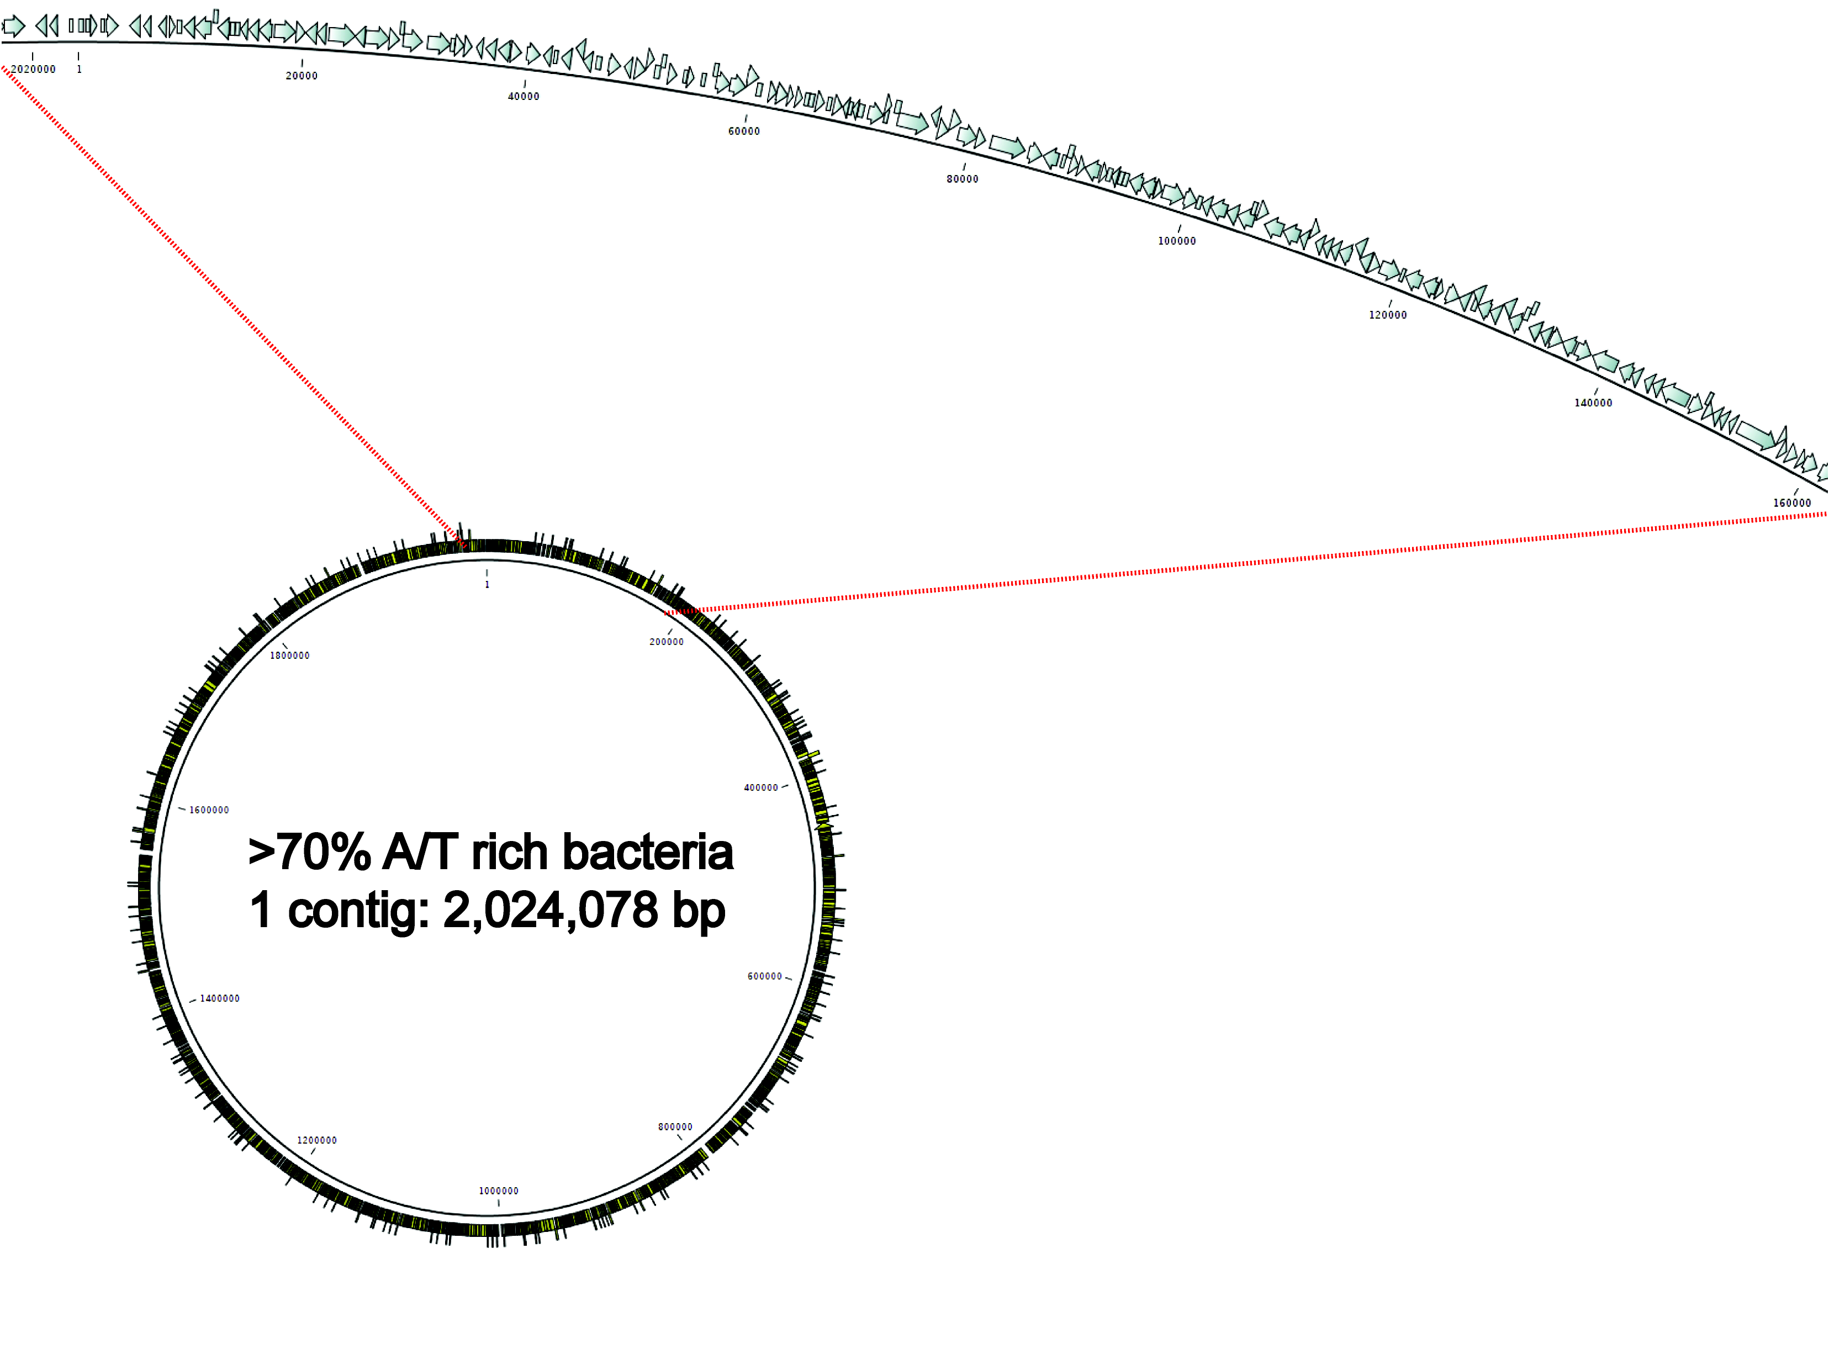
PacBio assembly, example result
Example: Complete assembly of a bacterial genome

Slide 29
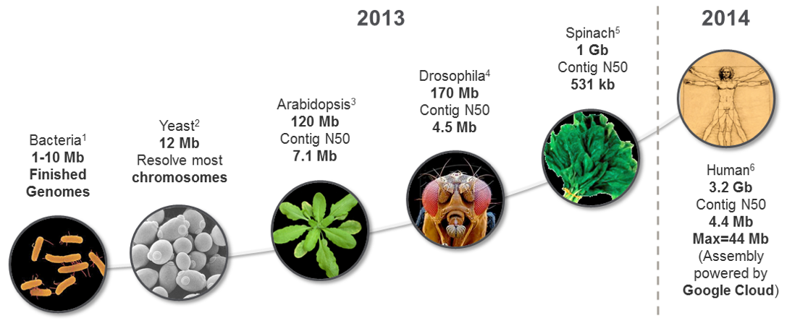
PacBio assembly – also for large genomes

Slide 30
De novo assembly of Swedish genomes
Long-read de novo sequencing of 2 individuals:
Reference genome
individuals
Male
Female

Slide 31
Available data for two reference individuals
Data type | Amount (per individual)
SMRT PacBio | 75X coverage
BioNano | 2 x 100X coverage
10X Chromium | 50X coverage
Illumina WGS | 30X coverage
Oxford Nanopore | 30X coverage
MGI | ??X coverage
Aim: use all this data to create high-quality references!

Slide 32

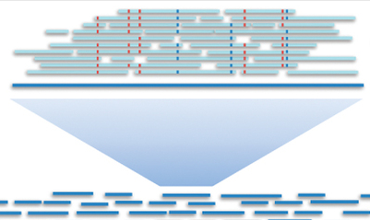
De novo assembly of 75X PacBio data
Assembly (FALCON)
Error correction (2 x Quiver)
Analysis time: ~3 weeks/genome
 | Individual 1 | Individual 2
Assembly size | 3,039,619,582 | 3,024,752,299
Nr contigs | 11,249 | 11,601
Longest contig | 36,8 Mb | 54,1 Mb
N50 | 8,9 Mb | 8,3 Mb

Slide 33
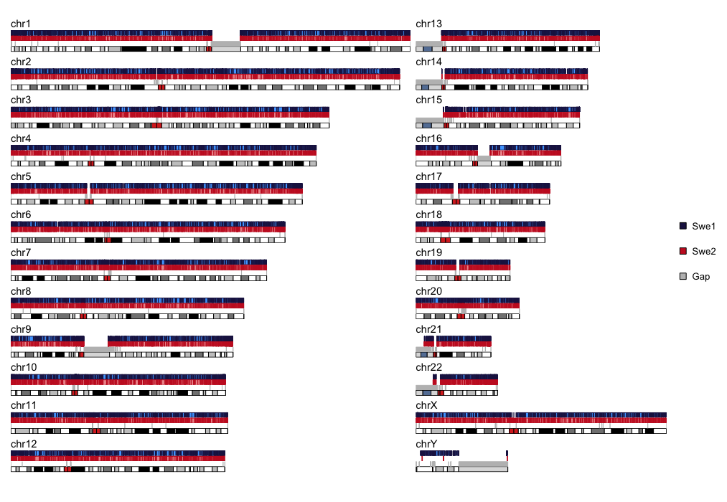
Aligning contigs to human reference
> 99% of bases can be aligned to human reference (hg38)
Individual #1
Individual #2

Slide 34

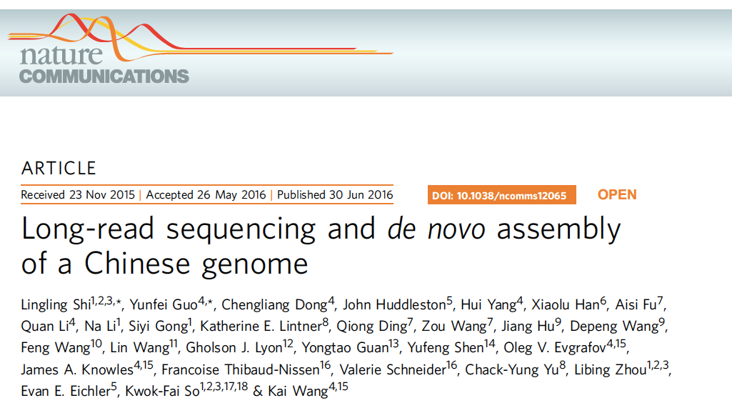
Discovery of ‘novel’ sequences
We find a lot of ‘novel’ sequence (NS), i.e. not matching hg38
Individual 1
Individual 2
Chinese
~14 Mb
~10 Mb
~13 Mb
Shi et al, 2016
Amount of novel sequences
~6 Mb of NS overlapping in all three genomes!
➔ Likely missing sequence in hg38 reference

Slide 35
Have novel sequences been seen before?
Results of BLAST of NSs to NCBI database:
Human BLAST hits:
Mainly BAC clones that have been Sanger sequenced but not placed in hg38
No hit:
Novel sequences, never seen before (or at least not deposited in a database)
Non-human primates:
Regions that have only been sequenced in primates before, but not in humans
Other:
A few interesting other things, including a complete HPV35 genome. And some parasitic worms!
Manuscript in preparation

Slide 36
Why worm DNA in human genomes???
Worm DNA found in the two Swedish genomes and Chinese!
Enterobius vermicularis
Dracunculus medinensis
Spirometra erinaceieuropaei
Our hypothesis: These “worm” sequences are in fact human, but erroneously annotated as worm DNA!

Slide 37
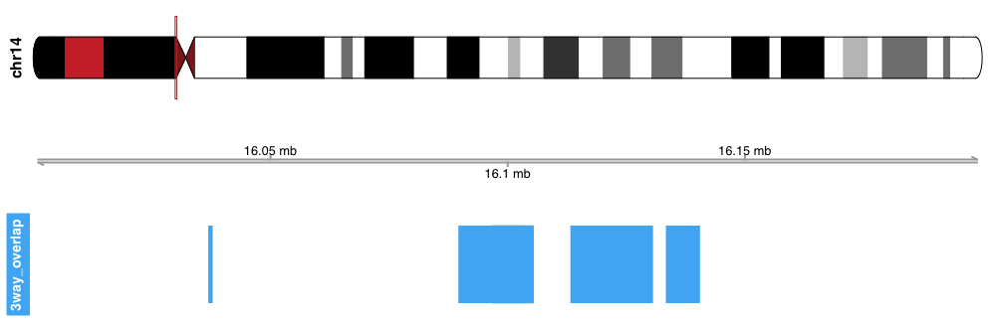
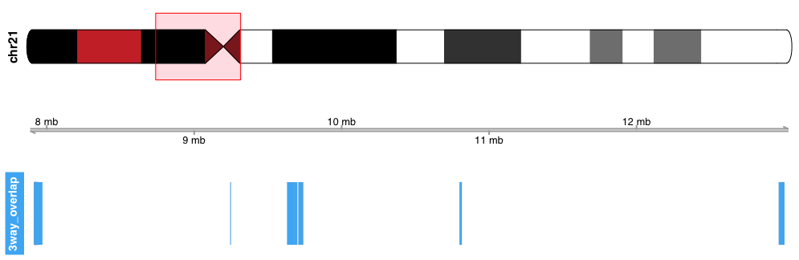
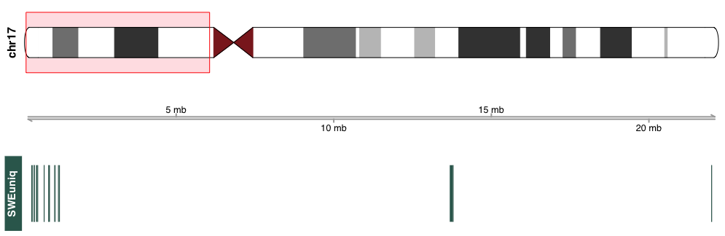
Novel sequences – examples
Ex 1: chr14
Missing in reference
(3-way olap)
Ex 2: chr21
Missing in reference
(3-way olap)
Ex 3: chr17
Population specific?
(not in Chinese)

Slide 38

What is the benefit of a Swedish reference?
Ongoing work:
Start from Illumina
WGS reads for the
1000 Swedes
Align to GRCh38
Align to GRCh38 +Swedish contigs
hg38
hg38
Compare results: nr aligned reads, mapping quality, SNPs, indels …

Slide 39
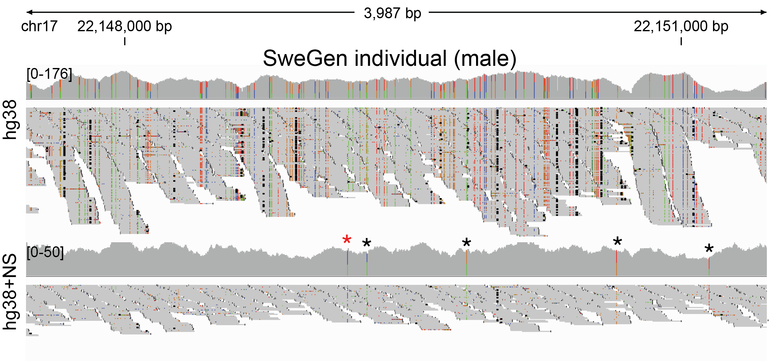
Cleaning up “ugly” regions in the genome
Some false positive SNPs seem to disappear!

Slide 40
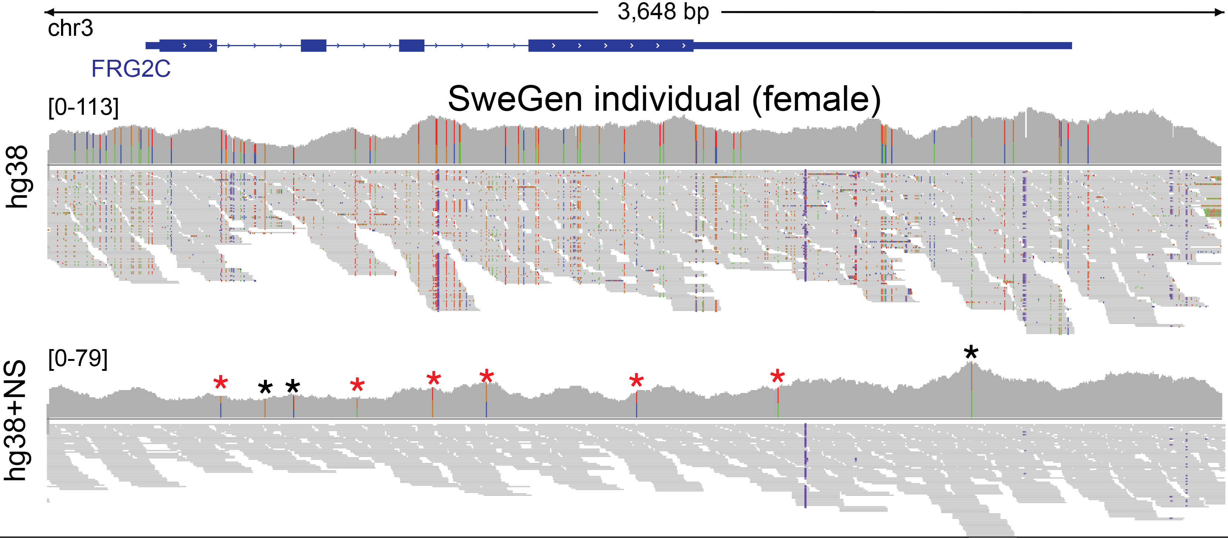
Cleaning up “ugly” regions in the genome (2)
Another example, in protein coding region!

Slide 41
Can we represent the genome as a graph?
”Goodbye reference, hello genome graphs”
Ameur A, Nat. Biotechnol. 2019
Recent genome graph i:
HISAT2/HISAT2-Genotype (Nat. Biotechnol. 2019)
Vg (Nat. Biotechnol. 2018)
Graph Genome Pipeline (Nat. Genet. 2019)

Slide 42
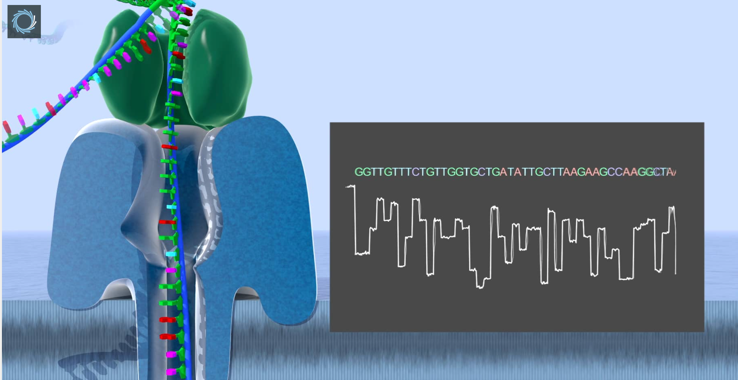
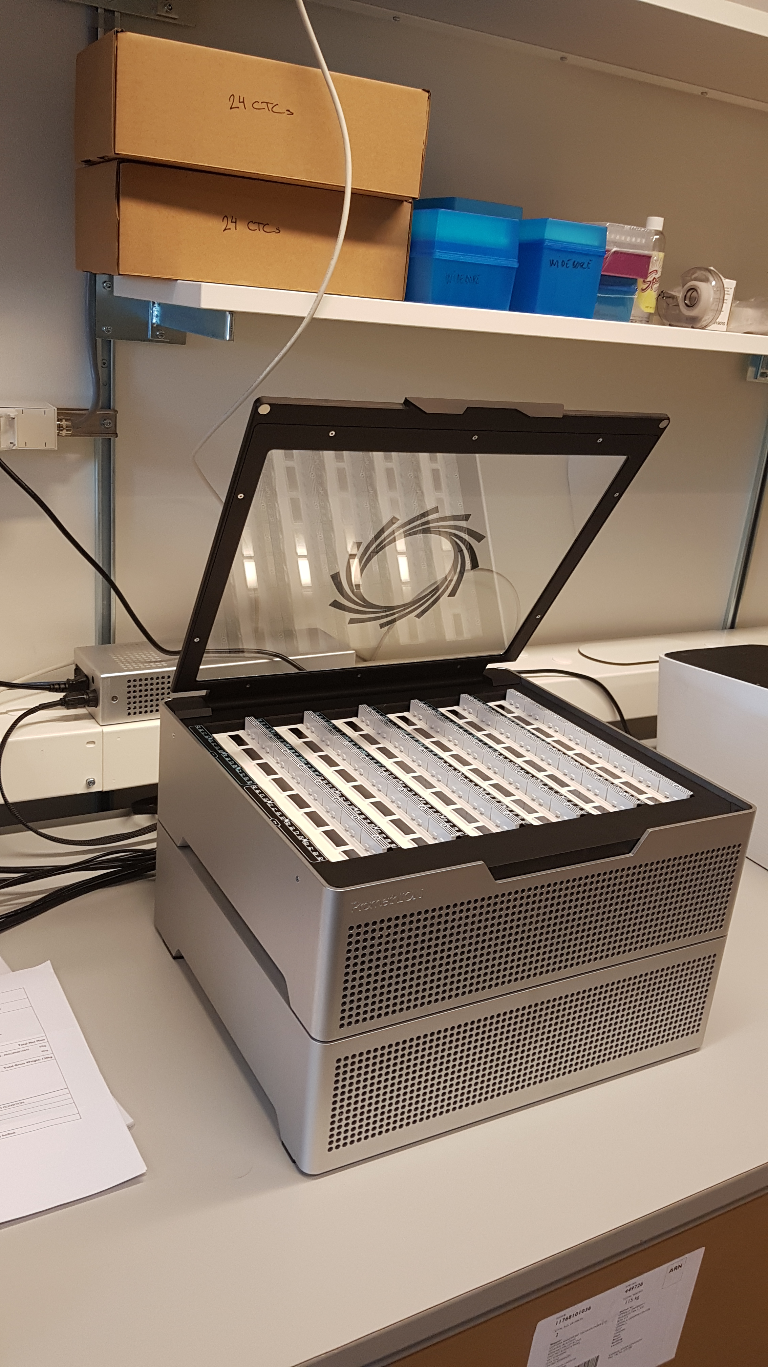
Human WGS on PromethION
~30X coverage from one flow cell
Read lengths up to 1 Mega base!

Slide 43
SV calling - Nanopore vs PacBio
Sample | Insertion (INS) | Deletion (DEL) | Duplication (DUP) | Inversion (INV)
Nanopore, Swe1 | 8746 | 7769 | 185 | 133
PacBio, Swe1 | 12,441 | 9052 | 331 | 196
Nanopore, Swe2 | 8369 | 7820 | 147 | 128
PacBio, Swe2 | 12,218 | 9101 | 291 | 193

Slide 44
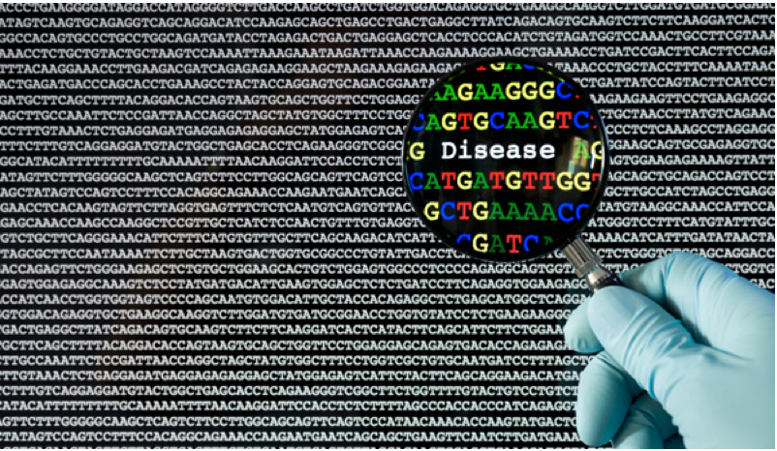
Long-Read sequencing in the clinic

Slide 45
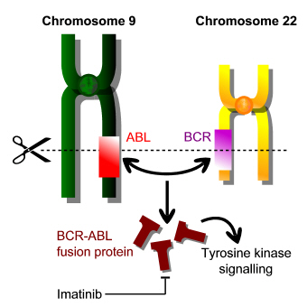
Project 1: Chronic Myeloid Leukemia
BCR-ABL1 - a drug target
The BCR-ABL1 fusion protein can acquire resistance mutations following drug treatment
www.cambridgemedicine.org/article/doi/10.7244/cmj-1355057881
Notes:
45

Slide 46
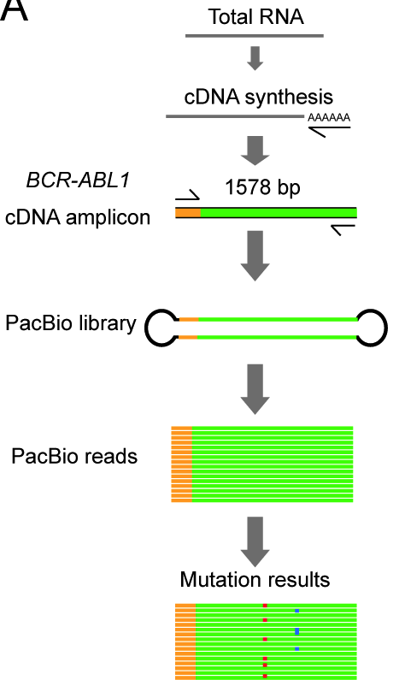
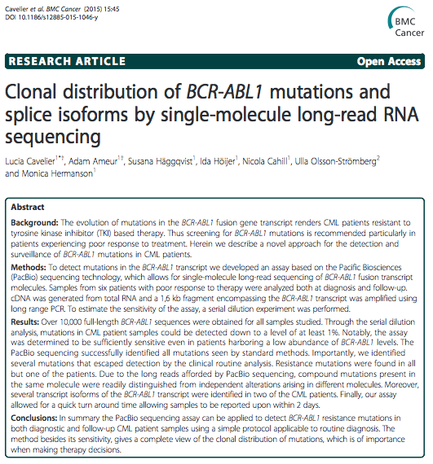
Our clinical diagnostics pipeline for BCR-ABL1
Notes:
46

Slide 47
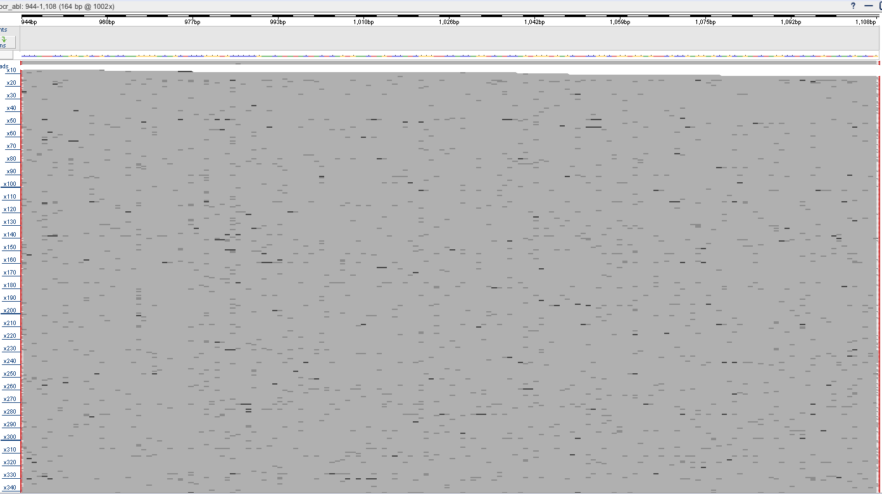
BCR-ABL1 mutations at diagnosis
PacBio sequencing generates ~10 000X coverage!
BCR
ABL1
Sample from time of diagnosis:
Notes:
47

Slide 48
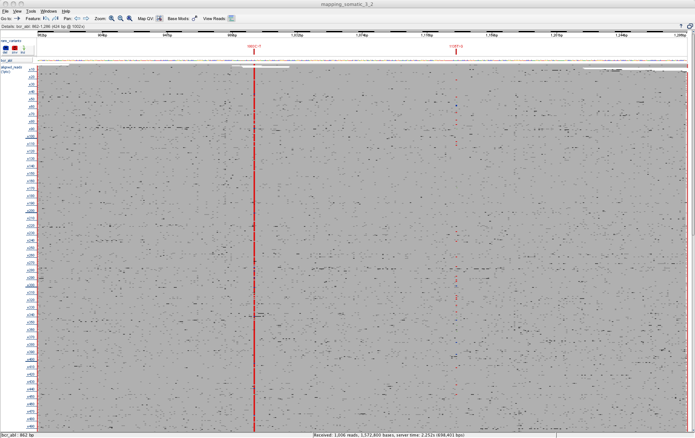
BCR-ABL1 mutations in follow-up sample
BCR
ABL1
Sample 6 months later
Mutations acquired in fusion transcript.
Might require treatment with alternative drug.
Notes:
48

Slide 49
PacBio BCR-ABL1 timeline
Notes:
The PacBio sequencer sequences from a PacBio DNA-template. The template is a ds DNA molecule with smart bells at the end. These contain a sequence where the sequencing primer binds and binding sites for the DNA polymerase.

Slide 50
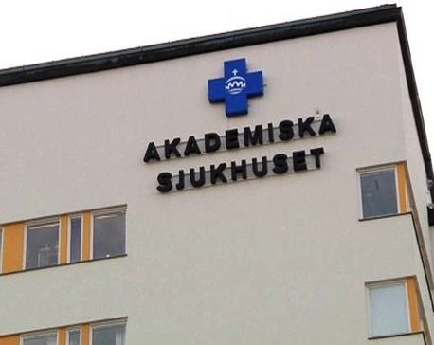
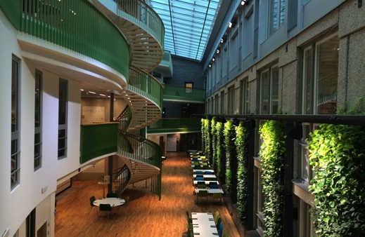
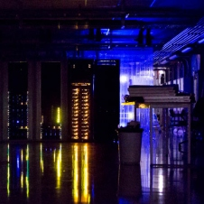
Clinical Diagnosis of BCR-ABL1 mutations
Clinical Genetics
Sequencing Facility
IT developers
Collection of samples
Seq library preparation
- SMRT sequencing
Automated data analysis
Web server for
results
Ongoing routine service, up to 4 samples/week
Over 250 samples run so far
100% consistency with Sanger results during pre-study and real time validation period
Notes:
50

Slide 51
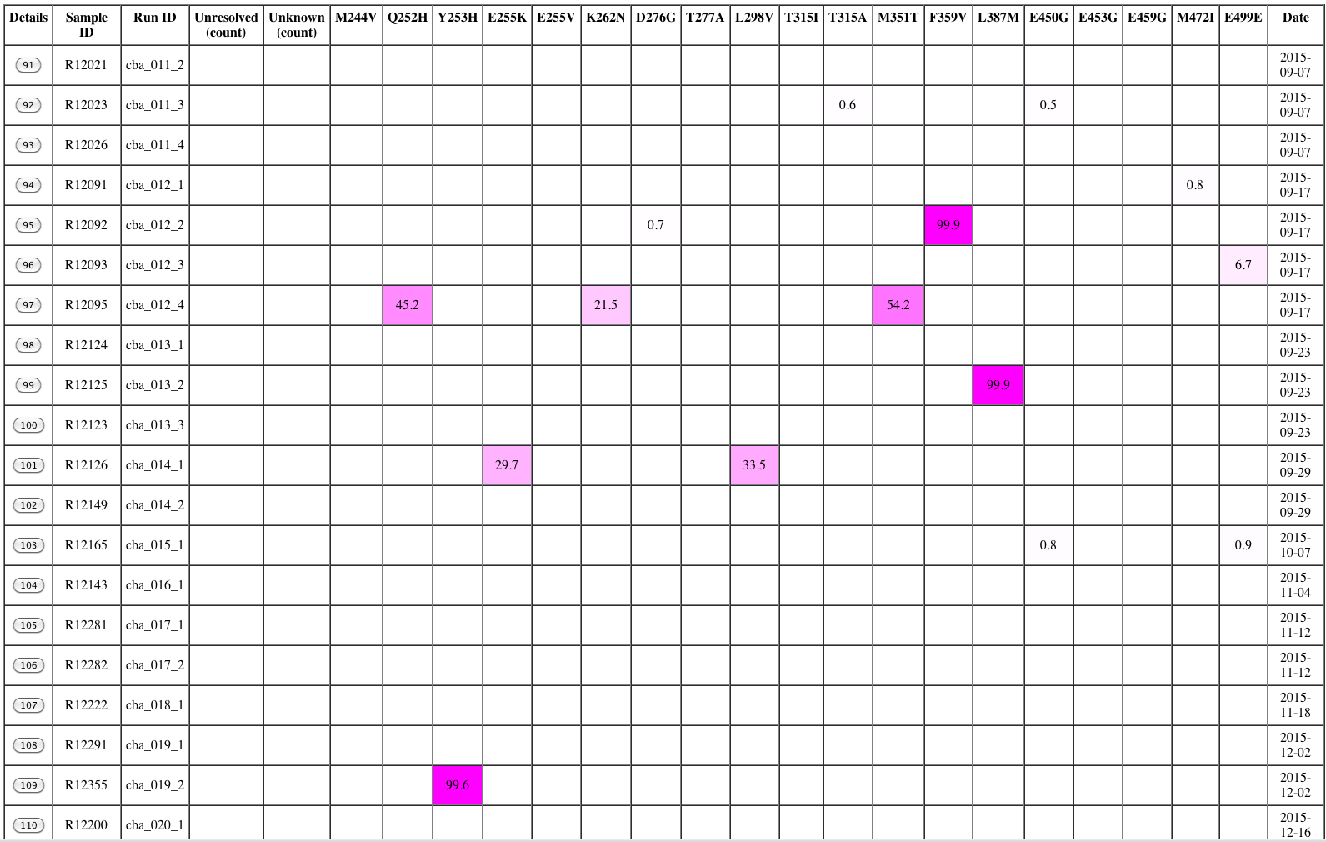
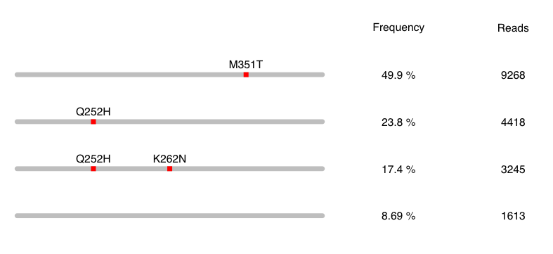
CML results viewed in our system

Slide 52
Example, patient with CML
M244V detected at 2,1%
Imatinib
Nilotinib

Slide 53
Many topics I have not covered…
ChIP-seq analysis
RNA-Seq
DNA base modifications
Single cell RNA-Seq
Simply too much to talk about in just one lecture…

Slide 54




Adam Phillippy
Kathy Below
Karen Miga
#LRUA20

Slide 55

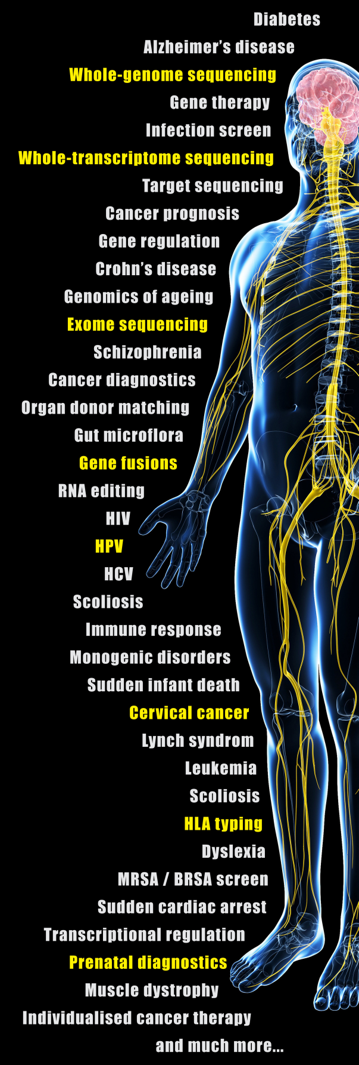
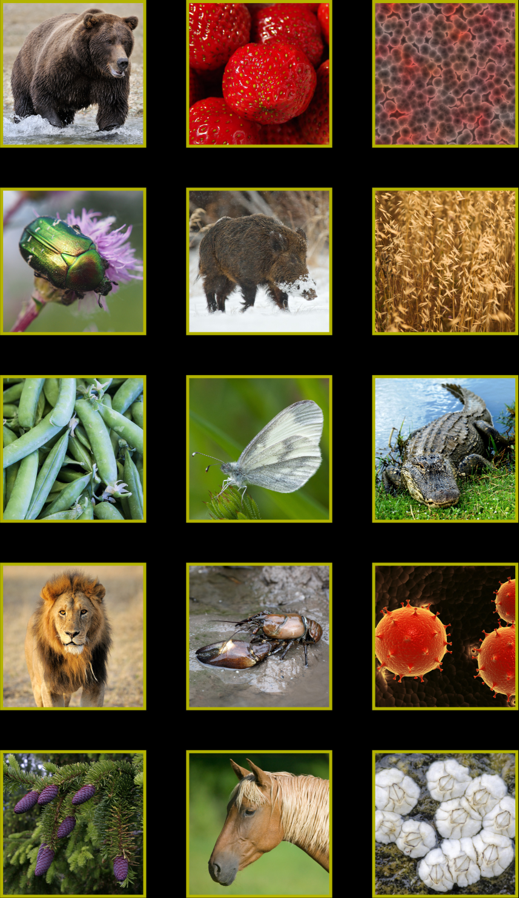
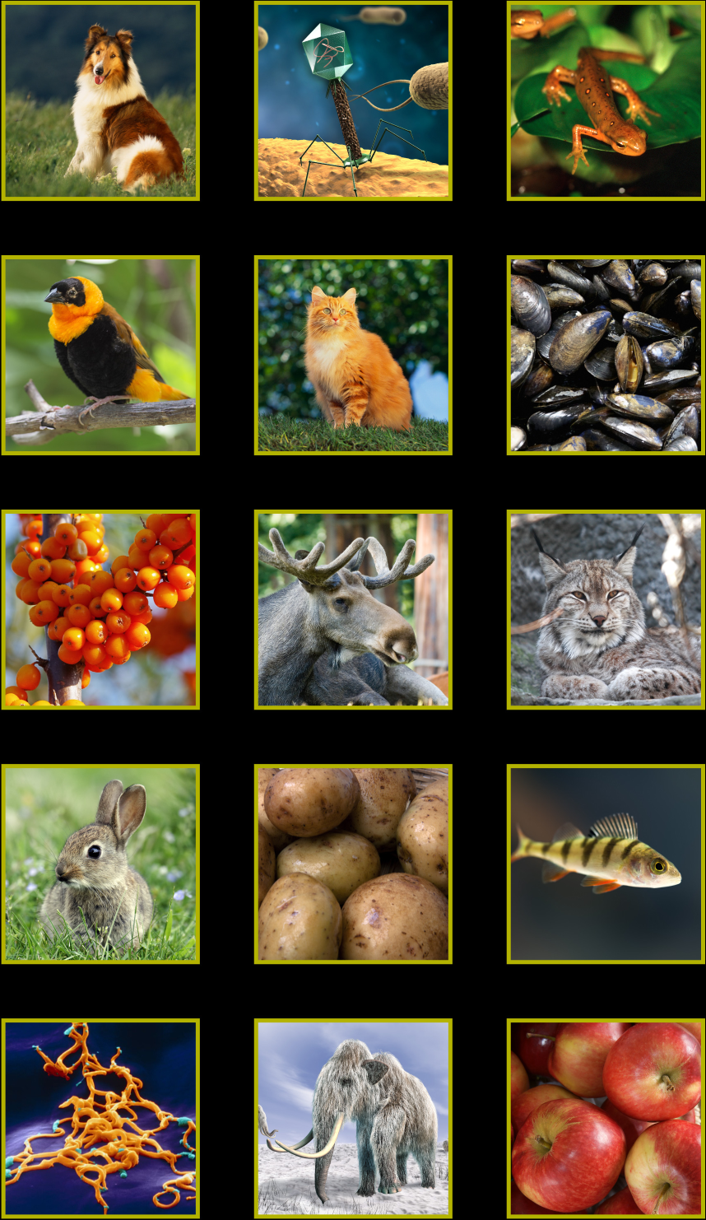
What we sequence at NGI /
THANK YOU

